Slide 1

Design and evaluation of a biomechanically consistent method for markerless kinematic analysis of sports motion
N.B.: Introduction in French, the rest in English
Jury members:
Valérier PERRIER: Chairperson (LJK, Grenoble INP)
Steffi COLYER: Main examiner (University of Bath, England)
Richard KULPA: Main examiner (Université Rennes 2)
Mickaël BEGON: Examiner (Université de Montréal, Canada)
Bruno WATIER: Examiner (Université Toulouse III - Paul Sabatier)
François BRÉMOND: Examiner (INRIA Méditerranée)
Lionel REVERET: Supervisor (Inria Rhône-Alpes)
Mathieu DOMALAIN: Co-supervisor (Université de Poitiers)
Doctoral school: Mathematics, Information Sciences and Technologies, and Computer Science
Specialty: Computer sciences
University: Université Grenoble Alpes (UGA)
Laboratories: Laboratoire Jean Kuntzmann (Grenoble), Laboratoire Pprime (Poitiers)
David Pagnon PhD Defense, March 10th, 2023, Grenoble (France)
Notes:
Bonjour à tous, merci d’être présents, et merci en particulier aux membres du jury qui se connectent à des heures indues du Québec, du Japon, ou encore depuis l’Angleterre. Quelques mots sur… Toutes les diapositives en anglais, mais je ferai mon introduction en français, avant de basculer en anglais… avec toutefois un accent français, pour que tout le monde comprenne
Welcome everyone! Just a short word about language: all the slides will be in English, but I’ll speak in French during the introduction, to make it a little more accessible. Then, I’ll switch to English – with a French accent.
Le titre de ma thèse pourrait se traduire par « Conception et évaluation d’une méthode biomécaniquement cohérente d’analyse cinématique sans marqueurs du geste sportif ». Ne vous inquiétez pas si ce n’est pas beaucoup plus clair, on va y aller progressivement.

Slide 2
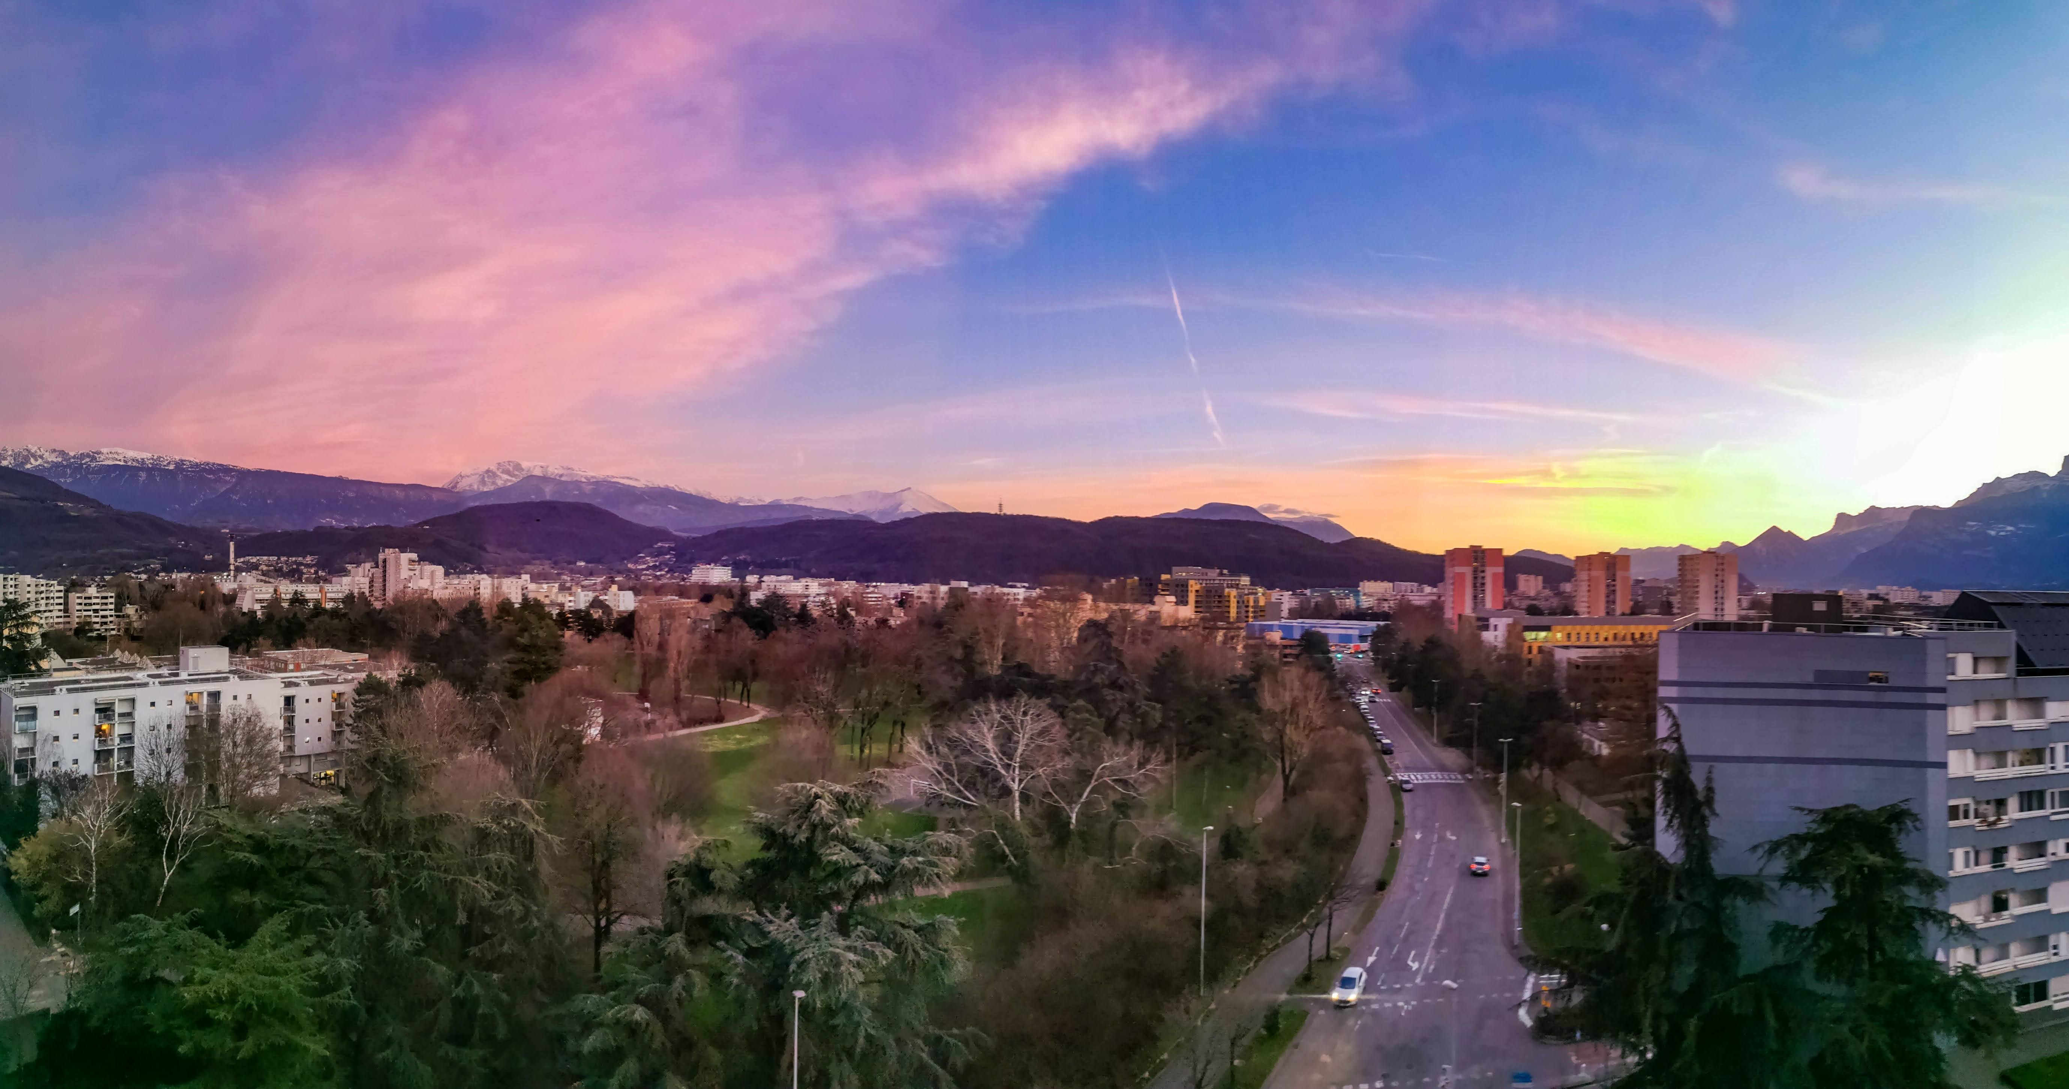
Table of Contents
01
02
Introduction
From 2D images to 3D joint angles
04
05
Accuracy
Application case
03
Robustness
What is MoCap?
Why do we need markerless in sports?
Crossover of numerous research fields.
Building an open-source solution.
Does it actually work? Comparing results
under challenging capture conditions
06
Perspectives
Comparison to a marker-based process.
Boxing, using unsynchronized and uncalibrated GoPros.
Enhancing the markerless process.
Data fusion when video is challenged
Notes:
Cette présentation s’articulera en 6 parties: Intro, puis
J’expliquerai comment on peut passer de la vidéo à des angles articulaires 3D, et j’en profiterai pour détailler l’implémentation de la solution que j’ai proposée.
Je testerai ensuite la robustesse du procédé, puis son exactitude, puis je l’appliquerai à un cas concret de mouvement sportif complexe.
Je terminerai enfin par les perspectives et la conclusion

Slide 3
Introduction
01
02
Introduction
From 2D images to 3D joint angles
04
05
Accuracy
Application case
03
Robustness
What is MoCap?
Why do we need markerless in sports?
Crossover of numerous research fields.
Building an open-source solution.
Does it actually work? Comparing results
under challenging capture conditions
06
Perspectives
Comparison to a marker-based process.
Boxing, using unsynchronized and uncalibrated GoPros.
Enhancing the markerless process.
Data fusion when video is challenged

Slide 4
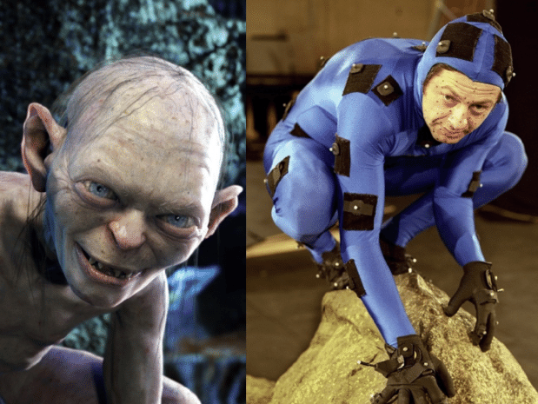
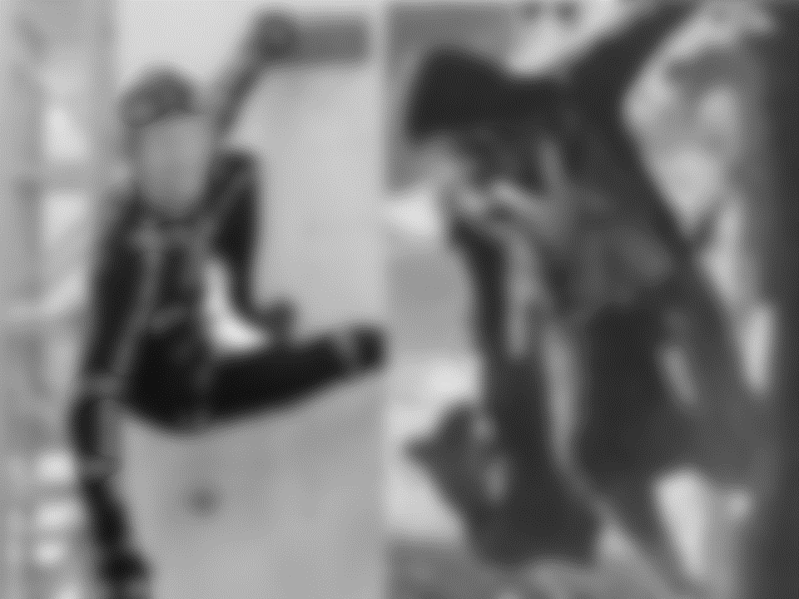
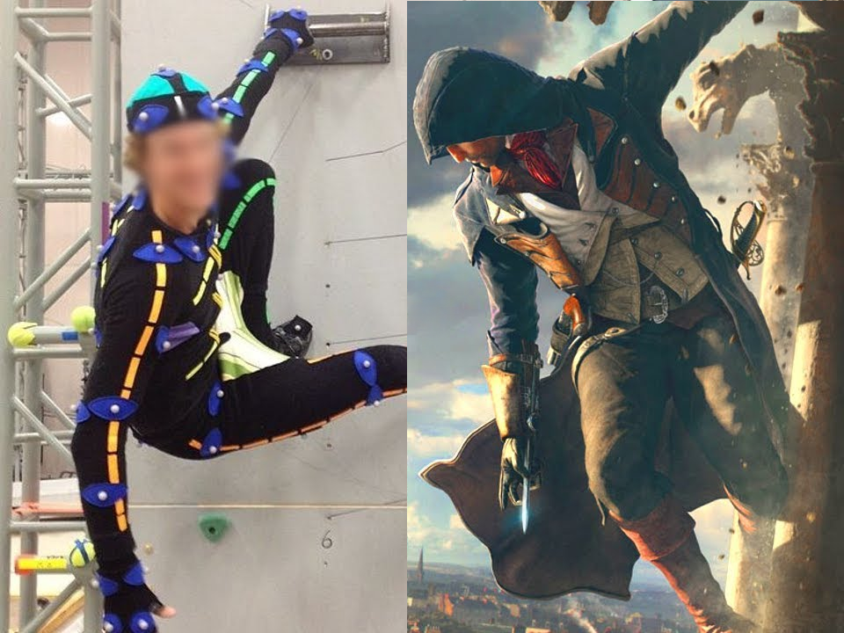
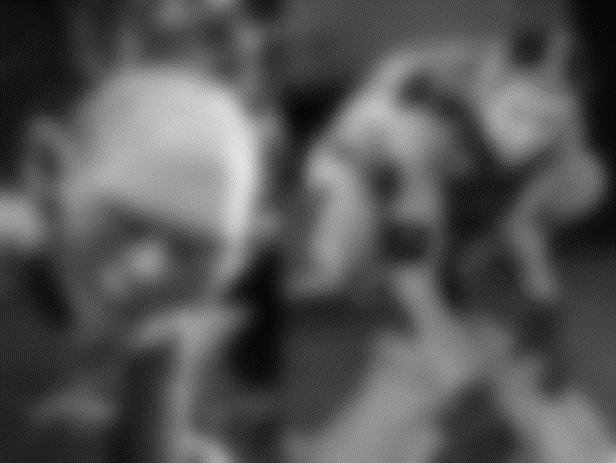
Introduction
Introduction What is MoCap?
This is Motion Capture = MoCap
More precisely, marker-based MoCap
Markers are tracked to render motion
Assassin’s creed, Ubisoft
The Lord of the Rings, Cinema-news.com
Notes:
Détectés pour restituer le mouvement

Slide 5
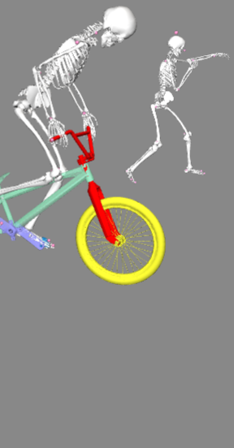
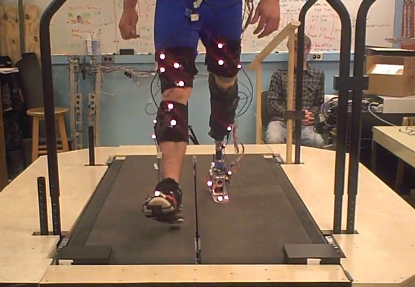
Introduction
Film and game industries
Sports
Medicine
Retargetting
the movements of an actor
to a character
Movement optimization,
Performance prediction,
Injury prevention
Prosthetics,
Decision support for surgery
Assassin’s creed, Ubisoft
Phasespace.com
Notes:
En majeure partie
Calquer le mouvement d’un personnage sur celui d’un acteur/cascadeur
Fabrication de prothèses, ou comme aide à la décision, par exemple pour déterminer s’il faut recourir à la chirurgie, ou si la kiné suffit
Dans une moindre mesure, à mi-chemin entre les deux, on trouve le domaine du sport…

Slide 6
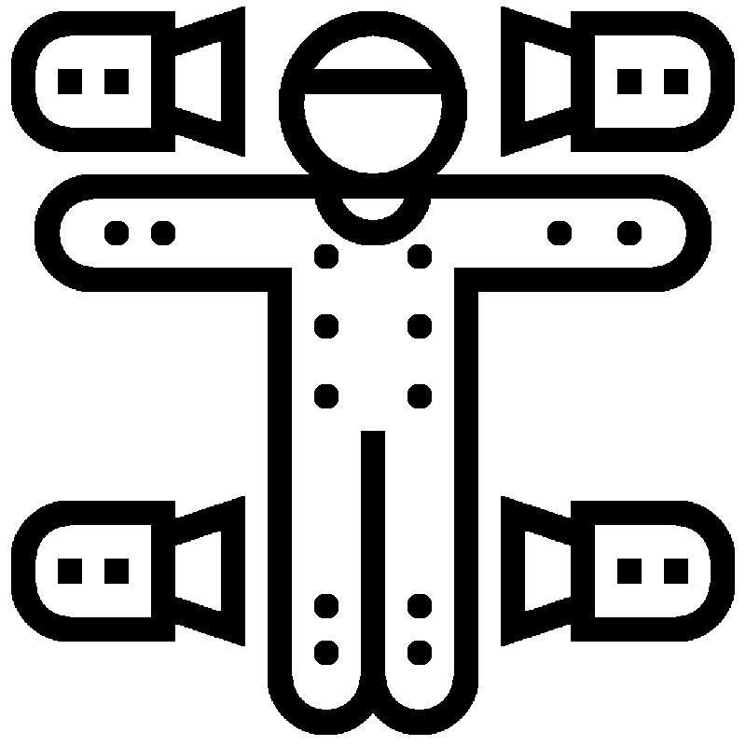
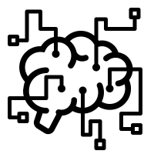
Introduction
Markers
System
However,
marker-based systems are impractical in sports
Cumbersome: hinders warm-up, movement and focus
Prone to placement errors and to soft tissue artifacts
Often occluded
Marker-based analysis is:
Used for research, not training
Far from the reality of the field
Sensitive to sunlight
Complex setup and analysis
Expensive
Need for markerless analysis
Notes:
Et pourtant,
Ça peut être dangereux: vous concéderez que ce n’est pas idéal lorsqu’on veut travailler sur la prévention des blessures…
Mouvements simplifiés, dans environnement simplifié

Slide 7
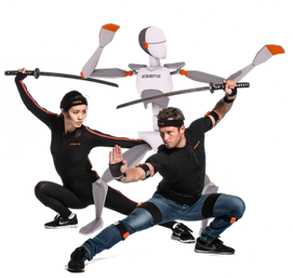
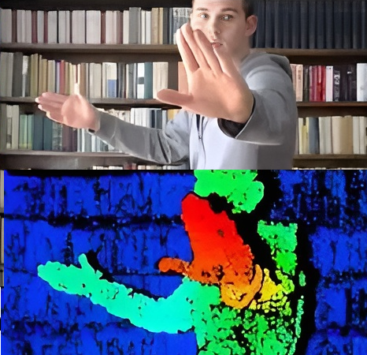
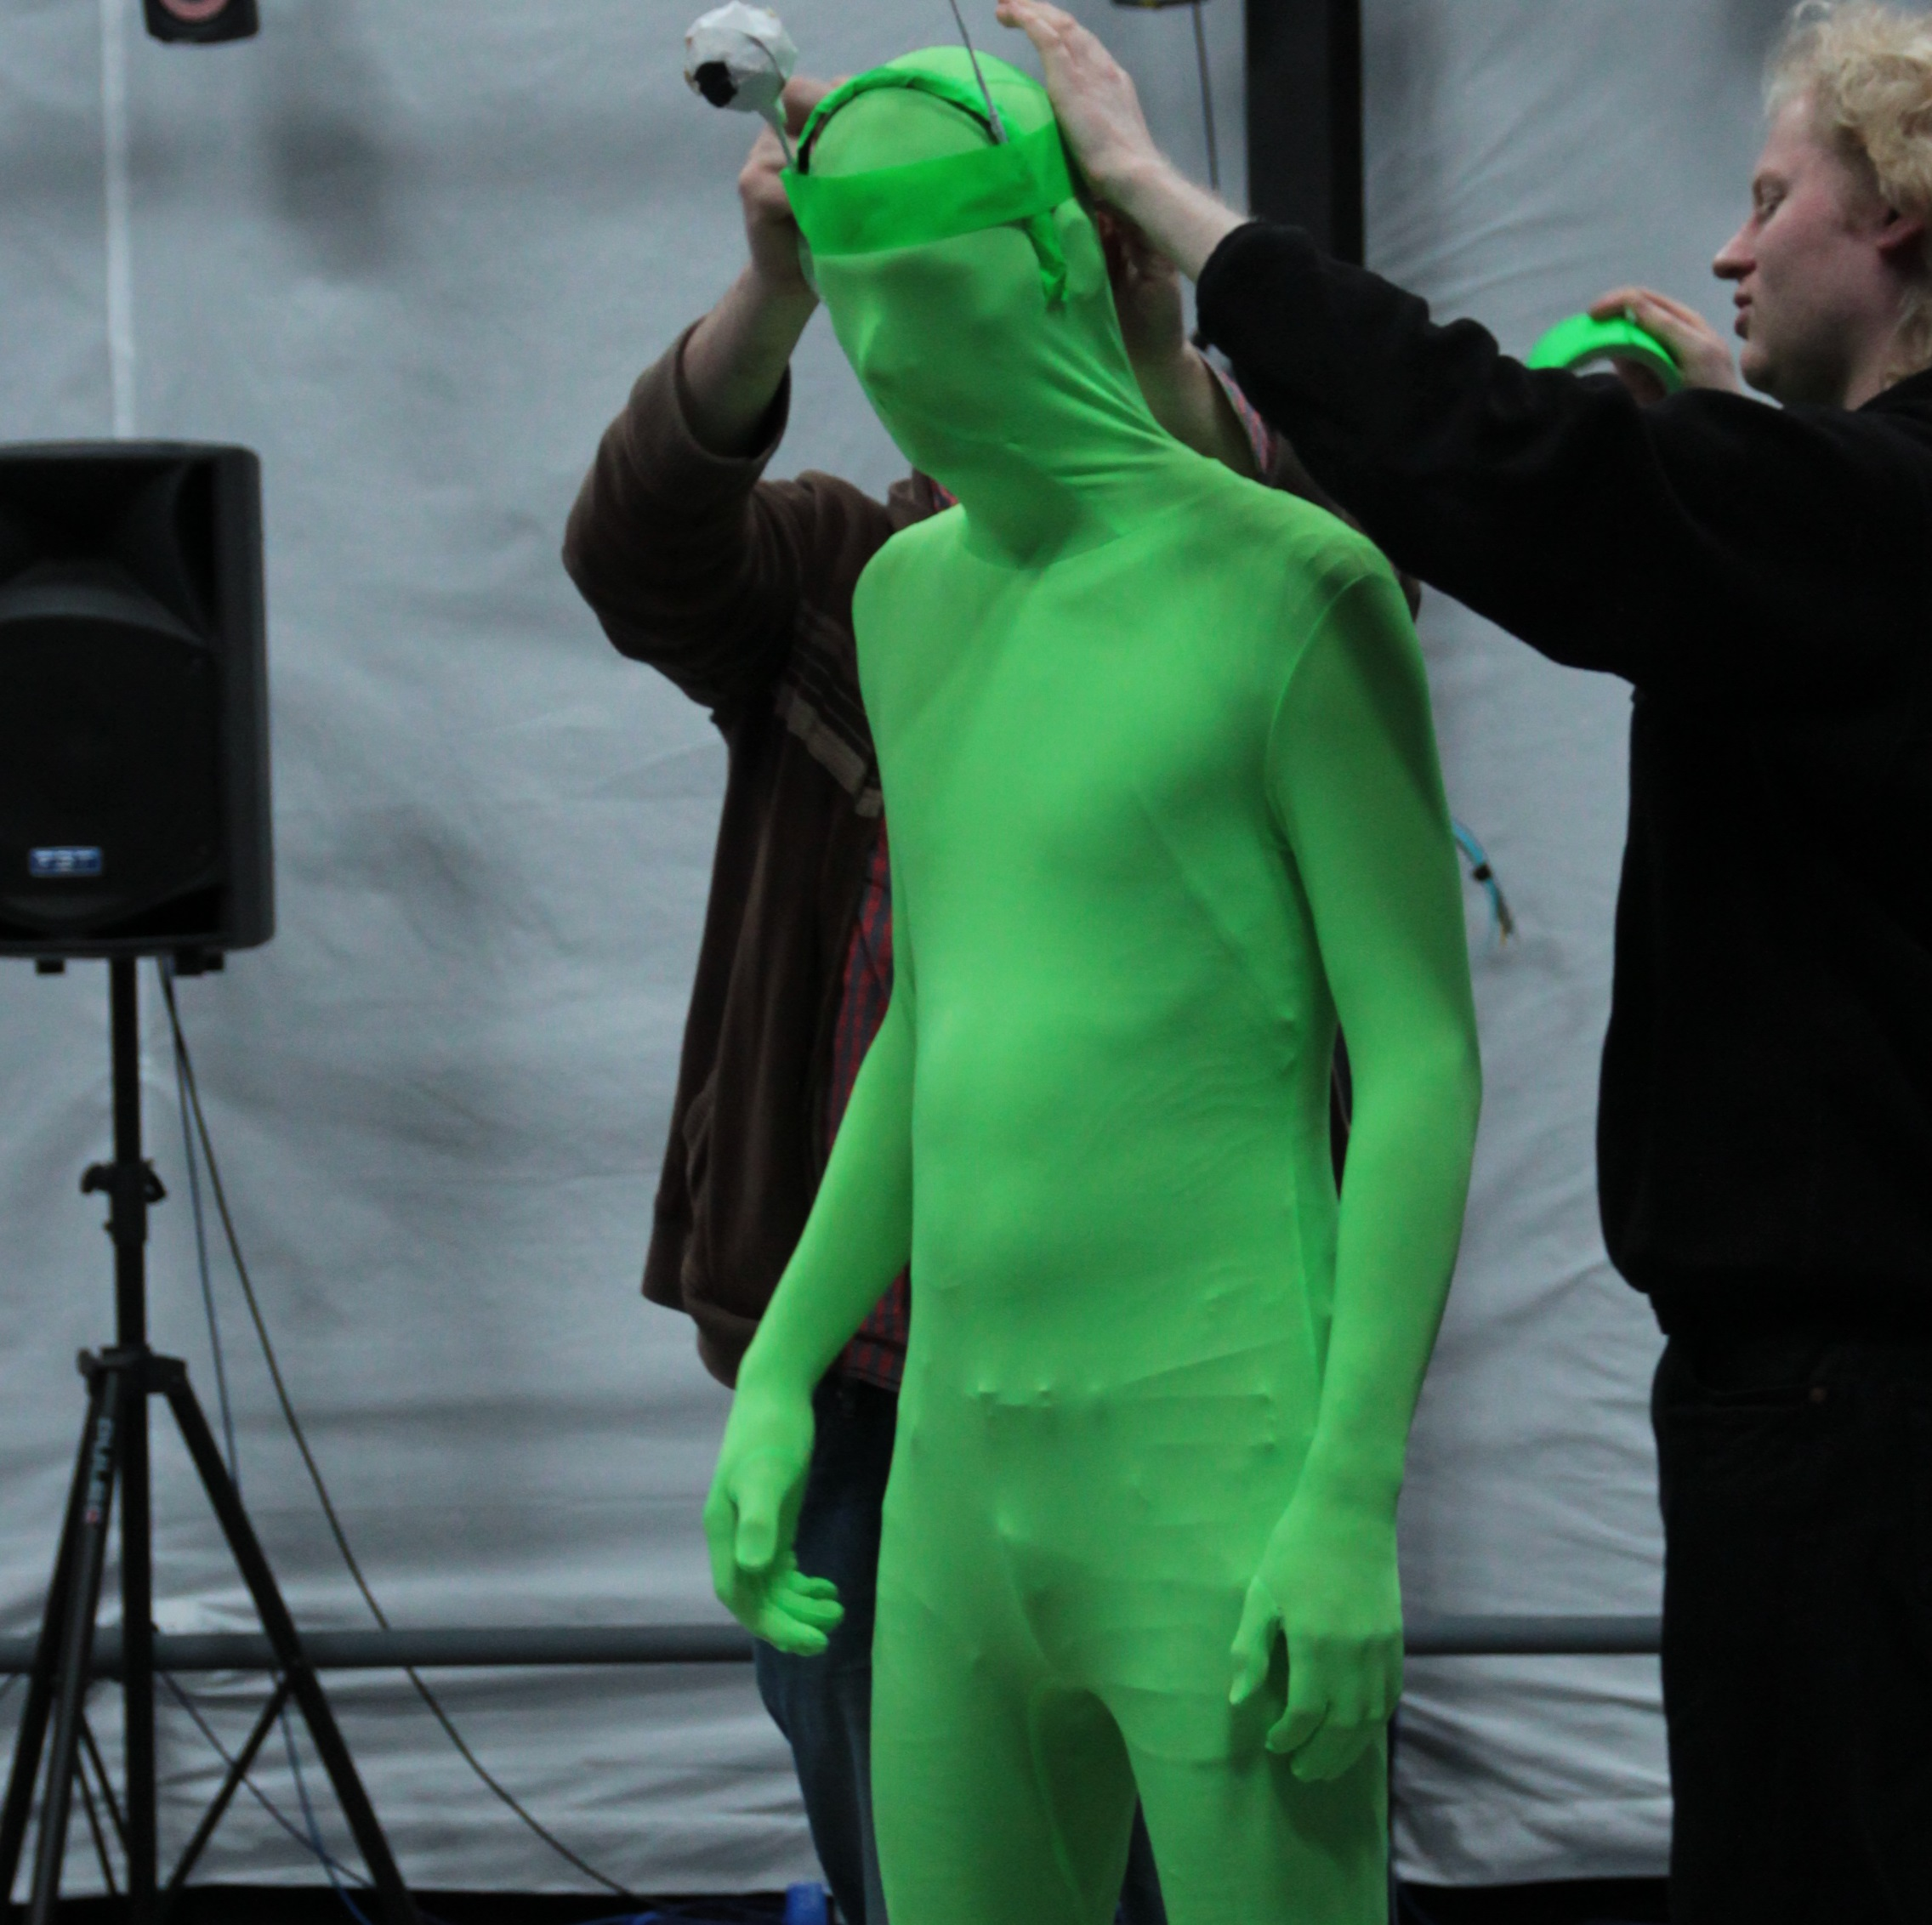
Introduction
Some attempts
of markerless MoCap
Movella.com
Ubergizmo.com
Dsdambuster.com
IMU sensors
RGB-D cameras
RGB camera network
Motion captured from accelerometer, gyroscope, and magnetometer. Ex: Xsens
✅ Easy to use, robust, cheap
❌ Drift, still something to wear
Remains an interesting compromise
Red-green-blue + depth sensor. Ex: Kinect
✅ True markerless, easy to use,
cheap
❌ Low framerate, short range,
sensitive to sunlight
Not the first choice for biomechanics
First attempts by background subtraction + visual hull
❌ Needs synchronized, calibrated cameras
❌ Constraints on outfit and background colors
Even less convenient than marker-based systems?
Notes:
Avant de rentrer dans le vif du sujet, il existe quelques méthodes qui permettent de se rapprocher de cet objectif
Qui alimente un champ de recherche dynamique
Portée
Soustraction de fond + Reconstruction d’enveloppe convexe. Costume ou arrière-plan. En l’état, encore moins pratique que…

Slide 8
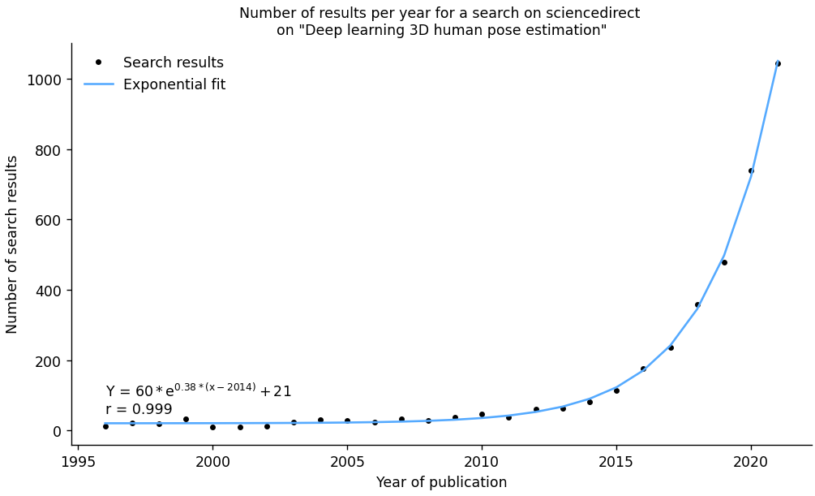
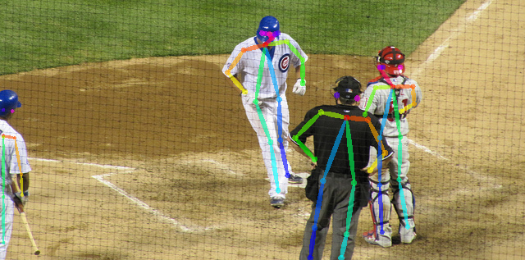
Introduction
But then came
deep-learning pose estimation on RGB cameras
[Cao 2019, IEEE]
✅ No marker placement, no soft tissue artifacts
✅ No special outfit
✅ Extremely robust to capture conditions
✅ Works with cheap cameras
[Pagnon 2021, Sensors]
Deep learning-based markerless analysis?
Notes:
Ceci est vrai jusqu’en 2015, où on observe l’explosion estimation pose par appr profond. Ceci a été rendu possible grace au développement de cartes graphiques puissantes et bon marché, encore une fois grâce à la pression du jeu video: les décors étant de plus en plus réalistes, ils nécessitent de plus en plus de calculs
Croissance exponentielle
La question qui se pose : Est-ce qu’on pourrait imaginer utiliser ces nouvelles options pour faire de l’analyse sans marqueurs ?

Slide 9
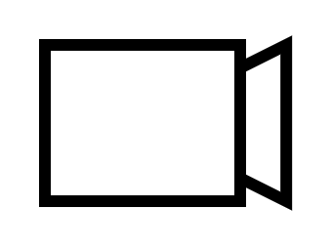
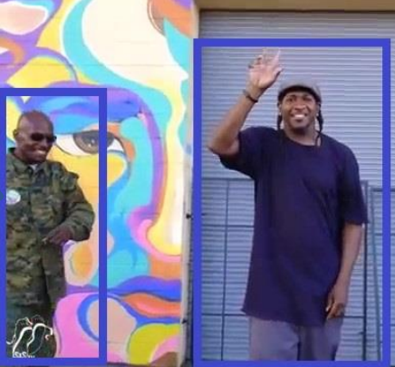
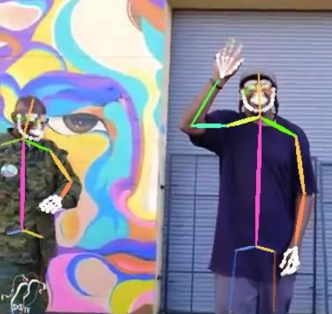
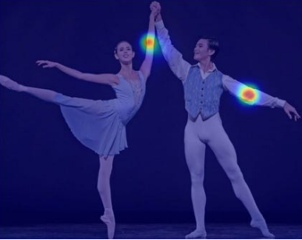
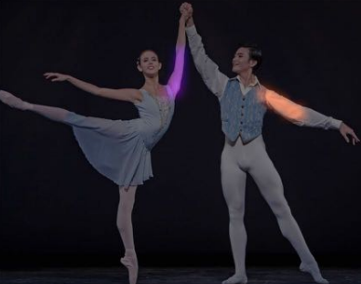
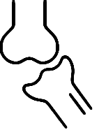
Introduction
Current state of the art
of markerless biomechanics
1
2D
2D pose estimation
The foundation
OpenPose: [Cao 2019]
The most widespread one. Extremely robust, reasonably accurate and fast. Bottom-up method: ↗ number of people ⇏ ↗ computing time.
BlazePose (Mediapipe) [Bazarevsky 2020]
DeepLabCut [Mathis 2018]
2
3D
Monocular
3D pose estimation
3D: exists!
BlazePose
SMPL suite
3
Multi-view
3D pose estimation
Occlusions: exist!
FreeMocap
EasyMocap
AniPose
3D
AlphaPose [Fang 2017]
OpenPose [Cao 2019]
4
Multi-view
3D joint angles
Skeleton: exists!
Theia
Pose2Sim
OpenCap
3D
+ YOLO-pose [Wang 2022], SLEAP [Pereira 2022], …
Notes:
Et d’ailleurs, où en est la recherche à ce sujet ?
Comme on vient de le voir, l’utilisation du deep learning pour l’estimation de pose est un domaine extrêmement dynamique, où une méthode révolutionnaire peut être rendue obsolète en quelques mois seulement. Je vais donc présenter donc un état de l’art actuel, plutôt qu’un état de l’art en début de these qui n’aurait pas grand sens. Gardez simplement à l’esprit, quand vous voyez les dates, que j’ai commencé en décembre 2019.
Commençons par la base, 2D: OpenPose: la plus répandue La méthode Classique, utilisée par AlphaPose, s’appelle la méthode top-down. Elle consiste à d’abord détecter toutes les personnes à l’image, puis de détecter les articulations pour chacune de ces personnes. La méthode bottom-up, mise en place par OpenPose consiste à d’abord détecter toutes les articulations à l’écran, puis à attribuer les segments aux personnes appropriées (part affinity field) -> Le temps de calcul est à peu près constant, quel que soit le nombre de personnes à l’image

Slide 10
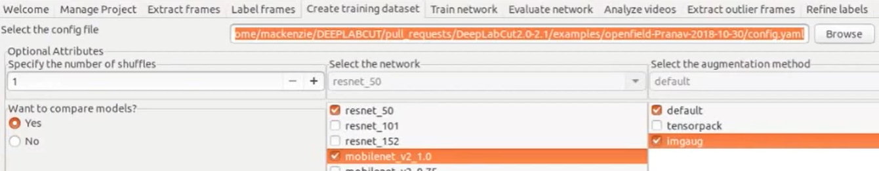
Introduction
Current state of the art
of markerless biomechanics
1
2D
2D pose estimation
The foundation
OpenPose: [Cao 2019]
The most widespread one. Extremely robust, reasonably accurate and fast. Bottom-up method: ↗ number of people ⇏ ↗ computing time.
BlazePose (Mediapipe) [Bazarevsky 2020] Extremely fast but less robust and accurate, and only single person detection. Detects a person on a frame, then tracks them until they are lost.
DeepLabCut: [Mathis 2018] Train model with your own keypoints. Choose architecture and parameters of the neural network.
2
3D
Monocular
3D pose estimation
3D: exists!
BlazePose
SMPL suite
3
Multi-view
3D pose estimation
Occlusions: exist!
FreeMocap
EasyMocap
AniPose
3D
AlphaPose [Fang 2017]
OpenPose [Cao 2019]
4
Multi-view
3D joint angles
Skeleton: exists!
Theia
Pose2Sim
OpenCap
3D
+ YOLO-pose [Wang 2022], SLEAP [Pereira 2022], …
Notes:
DeepLabCut: vient avec une interface graphique qui permet de choisir les points à détecter, mais aussi tous les paramètres d’entraînement.

Slide 11
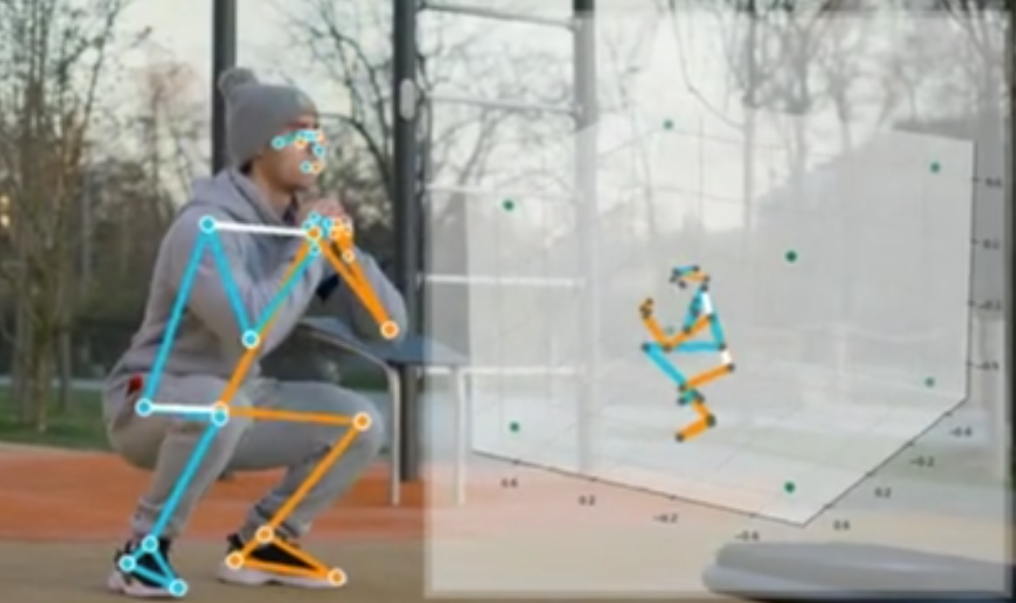
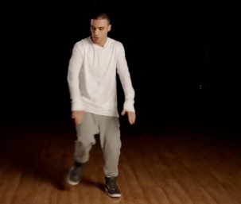
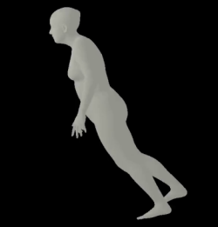
Introduction
Current state of the art
of markerless biomechanics
2
3D
Monocular 3D pose estimation
Sports movements are 3 dimensional!
BlazePose (MediaPipe): Also detects 3D keypoints from single camera Probabilistic guess: mostly interesting when accuracy is not critical.
SMPLify suite: 2D keypoints Regressor 3D SMPL shape [Bogo 2016] Common issue: person leaning forward Newer regressor: STRAPS [Sengupta 2020]; newer shape model: STAR [Osman 2020].
1
2D
2D pose estimation
The foundation
OpenPose
BlazePose
DeepLabCut
3
Multi-view
3D pose estimation
Occlusions: exist!
FreeMocap
EasyMocap
AniPose
3D
Mediapipe
4
Multi-view
3D joint angles
Skeleton: exists!
Theia
Pose2Sim
OpenCap
3D
[Rempe 2020]
Notes:
Malheureusement, 2 dimensions ne suffisent pas à décrire la plupart des mouvements sportifs. Certaines méthodes abordent cette tâche avec une seule camera.
- c’est le cas de… supposition, qui donne une réponse probable mais pas forcément exacte, surtout en cas d’occlusions. Quand exactitude pas consideration majeure
Utiliser un regresseur pour calquer une forme corporelle 3D (SMPL) sur une estimation de pose 2D (OpenPose eg).
Interessant pour animation 3D, mais pas suffisant pour biomechanics, où il faut se résoudre à devoir utiliser plusieurs points de vue

Slide 12
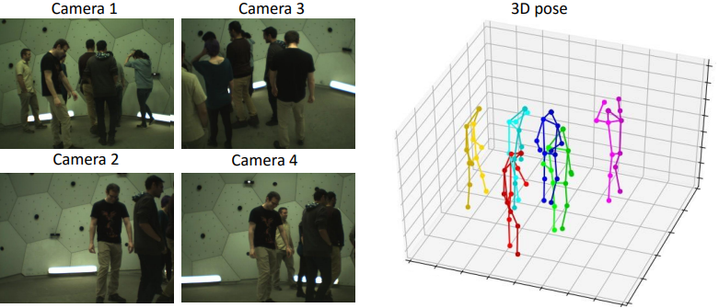
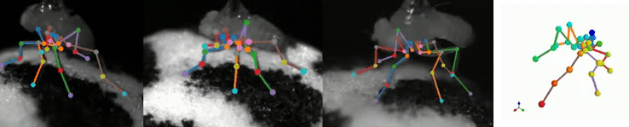
Introduction
Current state of the art
of markerless biomechanics
3
Multiview 3D pose estimation
Several viewpoints are needed to solve occlusions accurately!
FreeMocap: Naive but user-friendly OpenPose triangulation [Matthis 2022]
EasyMocap: Multi-person triangulation [Dong 2021]
AniPose: Triangulates data from DeepLabCut results [Karashchuk 2021]
1
2D
2D pose estimation
The foundation
OpenPose
BlazePose
DeepLabCut
3D
2
3D
Monocular
3D pose estimation
3D: exists!
BlazePose
SMPL suite
[Dong 2021]
4
Multi-view
3D joint angles
Skeleton: exists!
Theia
Pose2Sim
OpenCap
3D
[Karashchuk 2021]
Notes:
Intégration blender
Une fois qu’on a triangulé ces points, on n’est toujours pas prêts à faire de la mocap.

Slide 13
Introduction
Current state of the art
of markerless biomechanics
4
Multiview 3D joint angles
Constraints on segments and joints need to be satisfied!
Theia: [Kanko 2021]
First on the market, user-friendly, rather accurate. Not open-source! Black box, not flexible.
Pose2Sim: [Pagnon 2021] Our solution. Robust, accurate, and flexible.
OpenCap: [Uhlrich 2022]
Estimates coordinates of 43 markers from triangulated OpenPose keypoints.
Less cameras needed, but model might not work as well on untrained tasks.
User friendly, but requires sending data to their servers.
1
2D
2D pose estimation
The foundation
OpenPose
BlazePose
DeepLabCut
3D
2
3D
Monocular
3D pose estimation
3D: exists!
BlazePose
SMPL suite
3
Multi-view
3D pose estimation
Occlusions: exist!
FreeMocap
EasyMocap
AniPose
3D
Commercial but not peer-reviewed: The Captury, Simi Motion.
Peer-reviewed but not released: [Needham 2022]
Notes:
En effet, le squelette est une chaîne polyarticulée complexe, avec des contraintes articulaires. Je détaillerai plus tard ces contraintes, mais globalement un seul point par articulation permet seulement de determiner des angles de flexion/extension, alors qu’on voudrait pouvoir étudier également l’abduction/adduction, ainsi que la rotation interne/externe.
Dans l’ordre de publication.
Premiers à sentir l’opportunité. Parmi outils présentés, c’est d’ailleurs le seul outil non open-source, ce qui témoigne d’une ouverture intéressante dans le domaine de la recherche
P2S: On détaillera plus tard ses limites.
OpenCap : Réseau de neurons qui estime les positions de 43 marqueurs à partir de keypoints triangulés… Ensuite, l’analyse se fait exactement de la même manière qu’avec des marqueurs. Satisfait pas exigences européennes de souveraineté des données

Slide 14

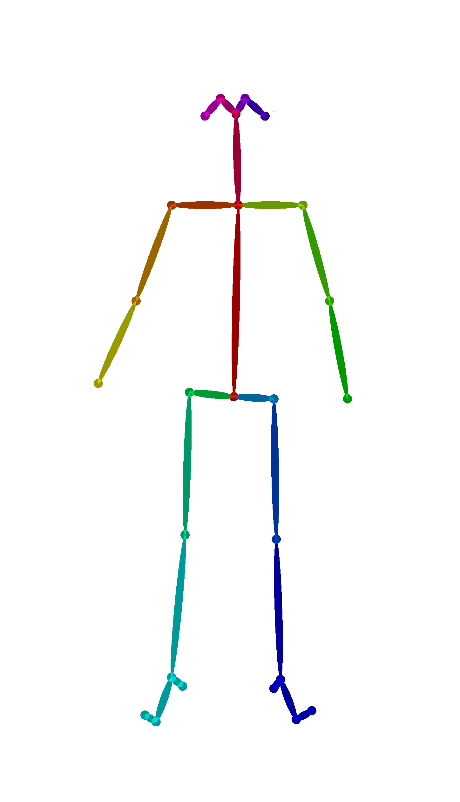
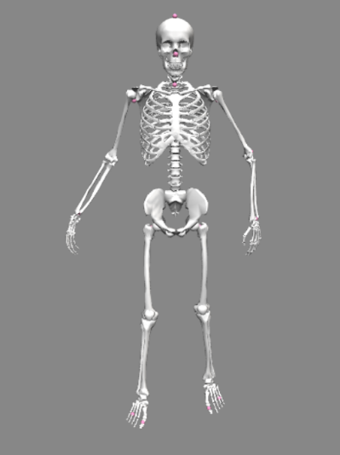
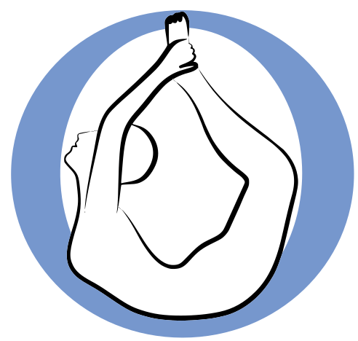
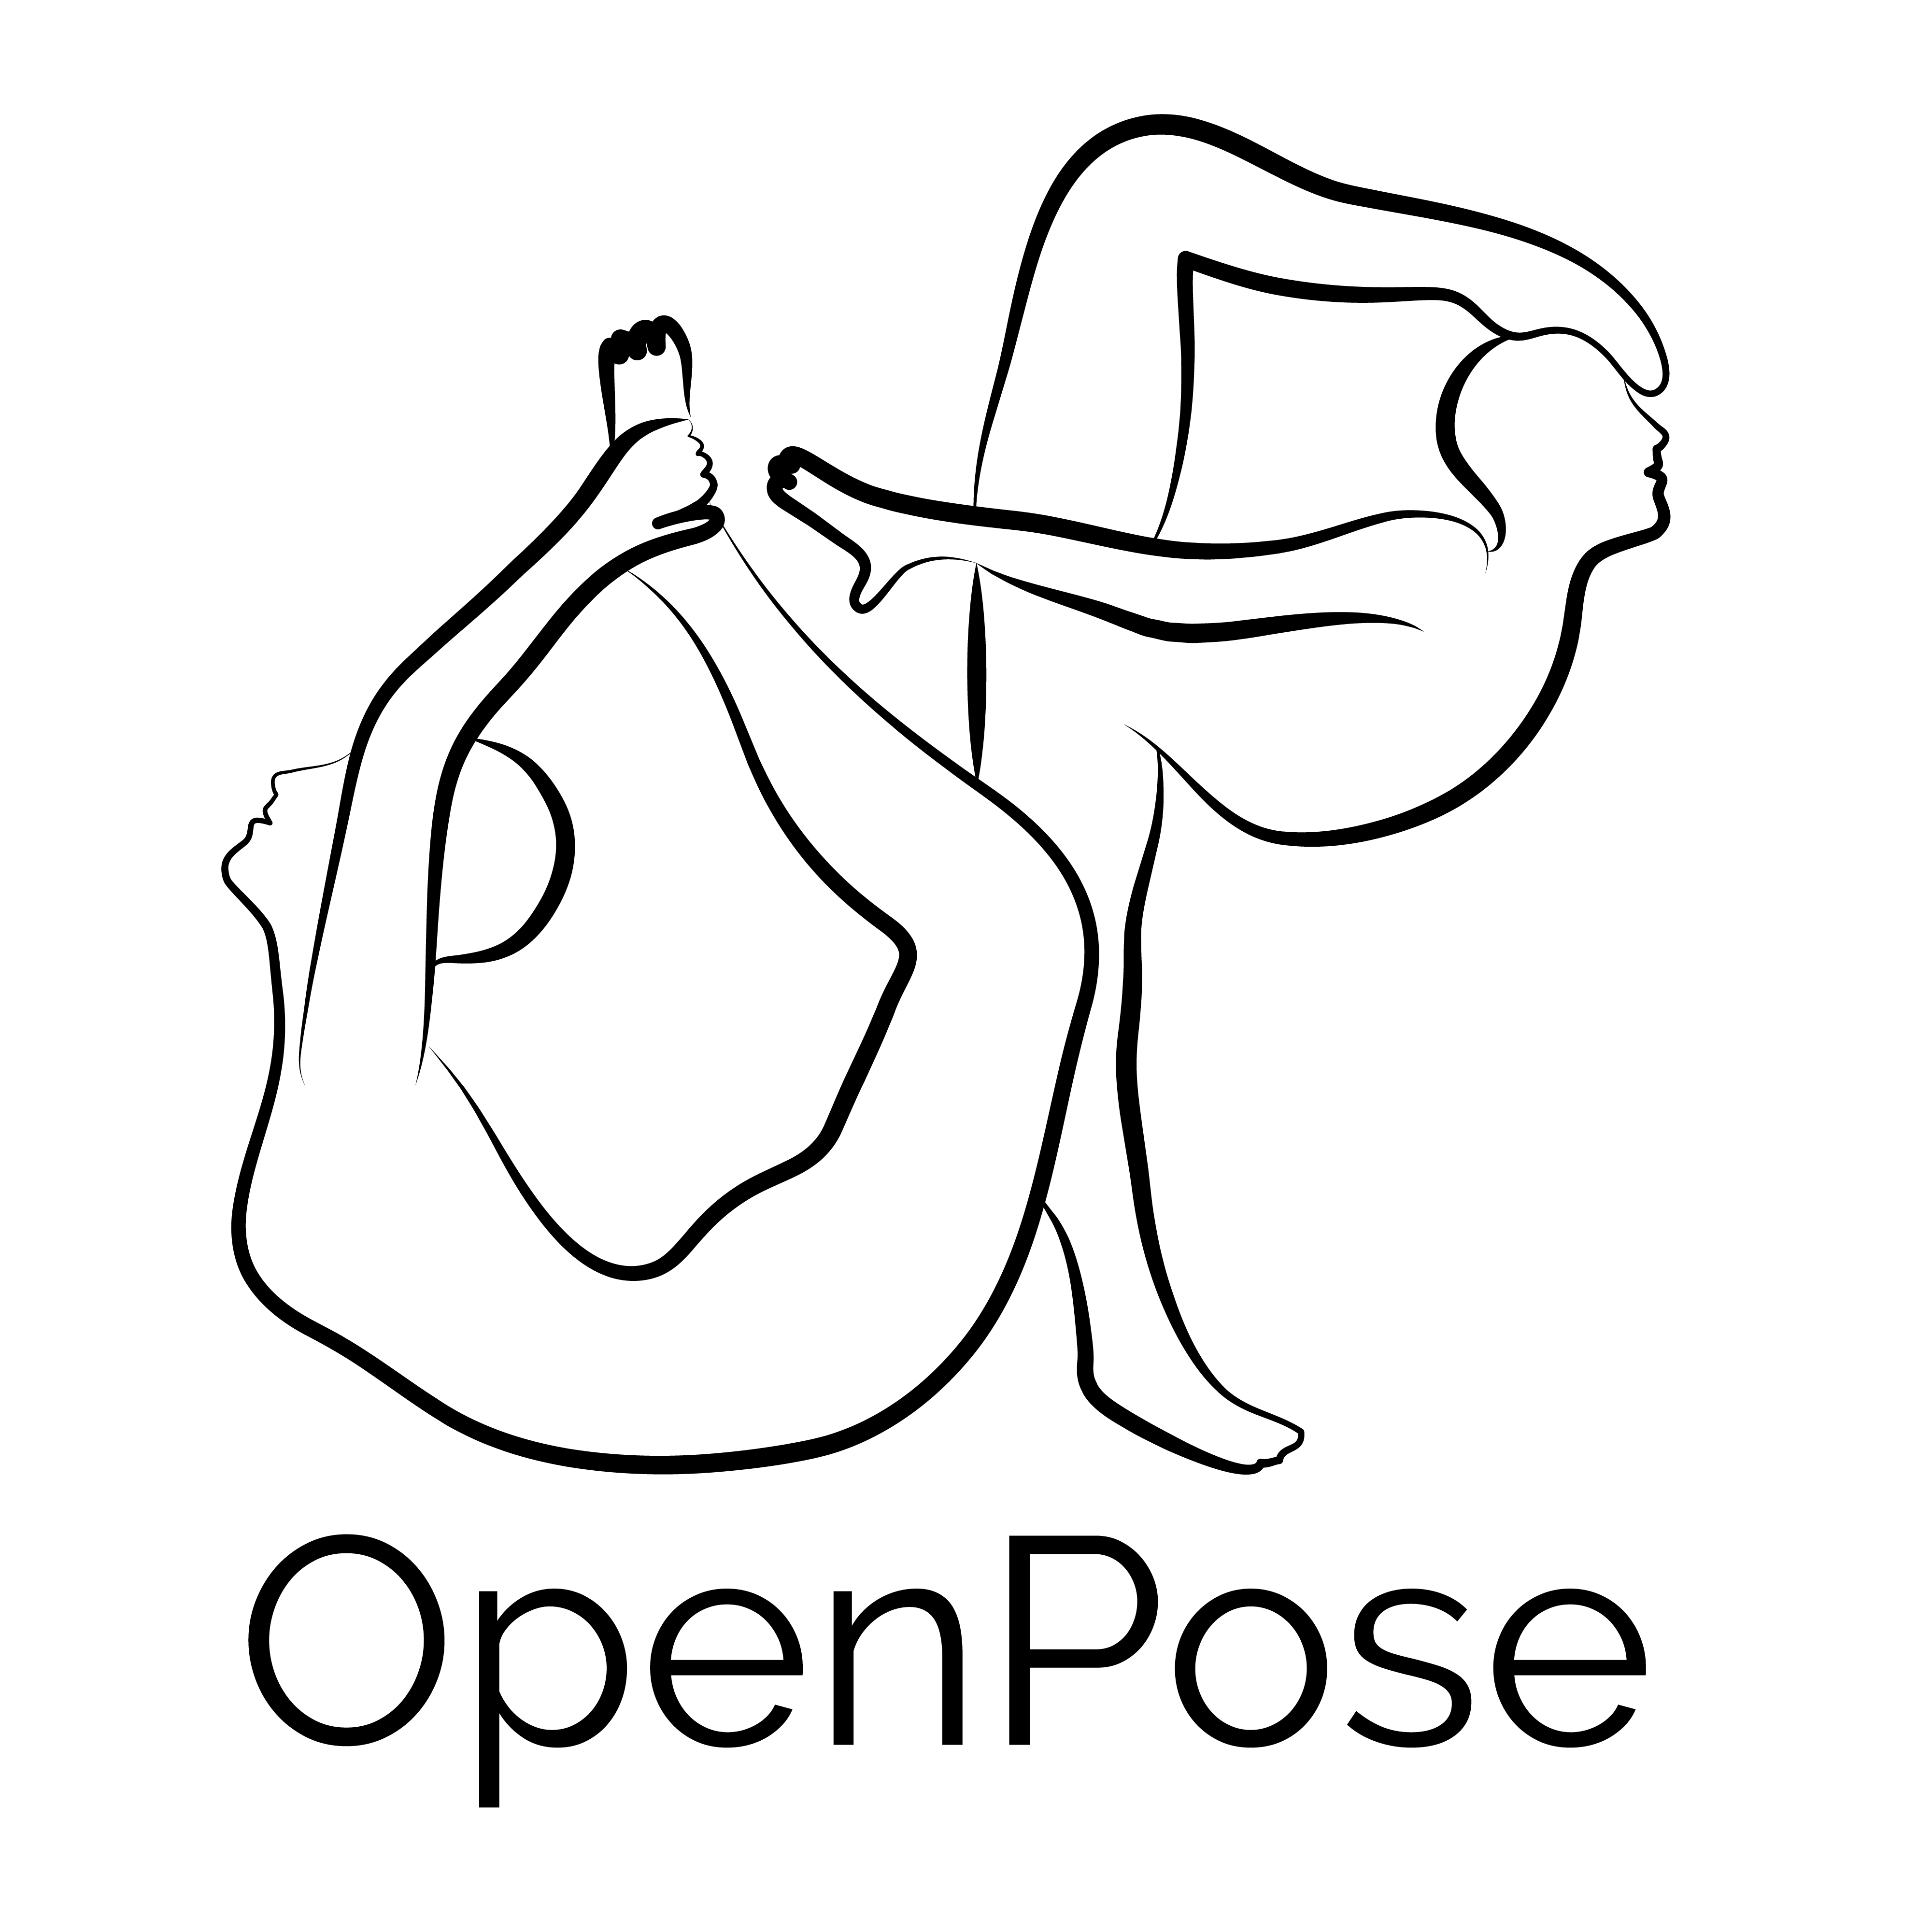
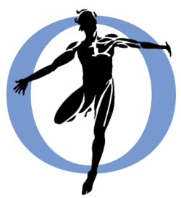
Introduction
Objectives
Bridging the gap between
Deep learning and Biomechanics
OpenPose
Deep learning
Video → 2D pose
Inaccurate?
OpenSim
Biomechanics
Markers → 3D joint angles
Incompatible with sports?
Pose2Sim
Computer vision
Notes:
2 des outils les plus reconnus par leurs communautés respectives, tous les deux open-source par ailleurs: OpenPose + OpenSim
Développer et évaluer Pose2Sim, qui impliquera plusieurs domaines de recherche (deep learning, computer vision, biomechanics)

Slide 15

Introduction
Objectives
Approaching an
ideal motion capture system
Ideal motion capture system:
⍰ Accurate
⍰ No interference with natural movement
⍰ Simple
⍰ Quick set up and analysis
⍰ Cheap
MoCap performance characteristics:
⍰ Robustness
⍰ Accuracy
⍰ Speed
[Atha 1984, Appl Ergon]
Developing and publishing an open-source tool
Challenging its robustness
Assessing its accuracy
Testing it in sports settings
[Moeslund 2001, CVIU]
Notes:
Mis en parallèle avec les caractéristiques de performances d’un système de MoCap telles que décrites par Moeslund and Granum
Mettre sa robustesse à l’épreuve, vérifier son exactitude, tester
Et c’est à peu près le plan pour la suite de la présentation, où je vais basculer en anglais.

Slide 16
2D images to 3D angles
01
02
Introduction
From 2D images to 3D joint angles
04
05
Accuracy
Application case
03
Robustness
What is MoCap?
Why do we need markerless in sports?
Crossover of numerous research fields.
Building an open-source solution.
Does it actually work? Comparing results
under challenging capture conditions
06
Perspectives
Comparison to a marker-based process.
Boxing, using unsynchronized and uncalibrated GoPros.
Enhancing the markerless process.
Data fusion when video is challenged
Notes:
This is where I’m going to delve into the details, in English.
The question is now: How can we manage to use simple vidéos, and obtain precise joint angles? I will also give more details about the development of the markerless solution I released

Slide 17
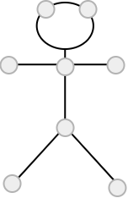
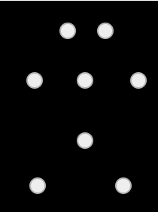
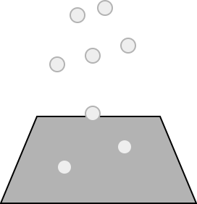
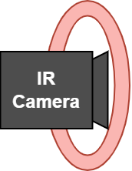

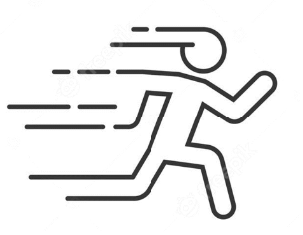
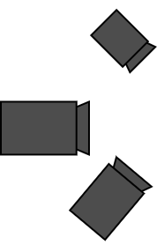
2D images to 3D angles
Preamble
How does marker-based MoCap work?
Marker placement
Infrared projectors
and cameras
Marker detection
Marker triangulation
Scaling model
Inverse kinematics
Calibration and
synchronization
Definitions:
Calibration: Camera properties and placement
Kinematics: Motion analysis
Direct kinematics: Marker positions from joint angles
Inverse kinematics: Joint angles from marker positions
Kinematic model
conception
Setup
Capture
Analysis
Notes:
First of all, how does classic marker-based kinematics work?
In the first place, one single trained operator puts markers
IR cams (very expensive, difficult in sunlight)
Calib & synchro: good user-end tools
In multi-body approaches, a model needs to be designed: OpenSim, Visual3D…. Small, big, long arms and short torso, or the opposite…

Slide 18
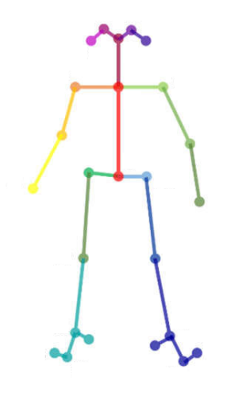
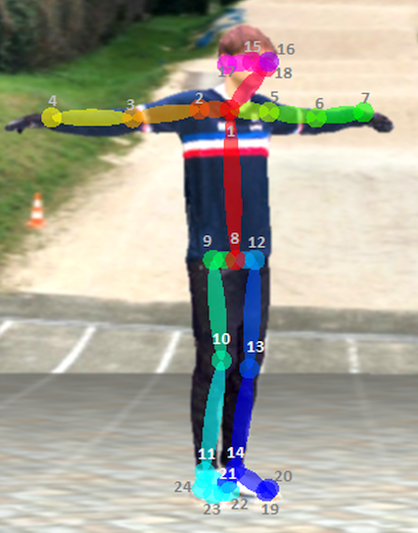
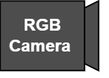
2D images to 3D angles
A markerless implementation
Pose2Sim, an open-source package
[Pagnon, 2022, JOSS]
Labeling and
model training
Marker placement
Marker detection
Infrared projectors
and cameras
Keypoint detection
RGB cameras
Person reidentification,
Keypoint weighted triangulation
Marker triangulation
Idem
Idem
Scaling model
Inverse kinematics
Idem
Calibration and
synchronization
Idem
Kinematic model
conception
Setup
Capture
Analysis
Notes:
Our markerless method will be heavily inspired from this:
Train model (DeepLabCut) or get pre-trained model (OpenPose)
Consumer grade cameras
Cal & sync less trivial, come back to it in the last part of the presentation
Kinematic model idem, although may be more constrained because of the small amount of keypoints

Slide 19
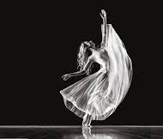
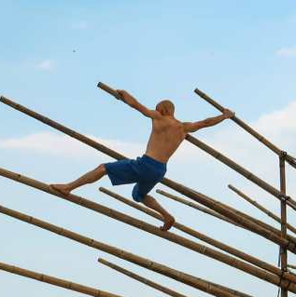

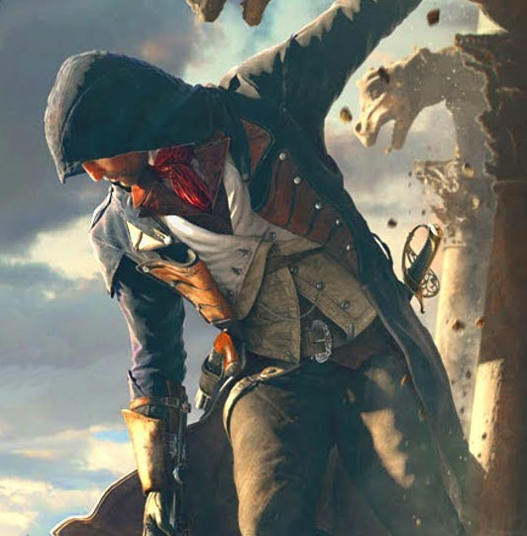

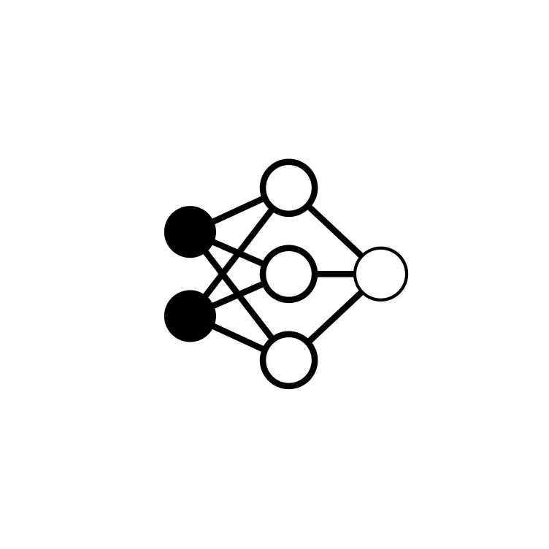


2D images to 3D angles
Labelling
Training
2D pose estimation
With deep learning
Keypoints labelled by humans on 1000s of images
After choosing a network architecture and its parameters:
Network guesses keypoint positions
Error calculation → update weights
Several iterations on different images until correct positions
➜ The network has learned: model ready to be used
Nicola Barts
Hand-labelled right shoulder
First guesses during training
Detecting keypoints on real data
Inferring
Notes:
As a consequence, the first step is 2D pose estimation
Labelling: usually very time consuming and not fun (unless tricks)
Training: architecture, iterations, batch size, training fraction, image augmentation method…
Little bit of a black box: intuition, trial and error

Slide 20
2D images to 3D angles
Labelling
2D pose estimation
With deep learning
Training
Inferring
Several options
Whole process from scratch: Tedious, unnecessary
Transfer learning: Label less images, train less long (e.g. DeepLabCut)
Pretrained model: Use as is (e.g. OpenPose)
Nicola Barts
Hand-labelled right shoulder
First guesses during training
Pose2Sim validation used the most accurate model from OpenPose (body 25B)
Other OpenPose models, BlazePose, DeepLabCut, and AlphaPose also supported.
Notes:
Transfer learning: first layers, features that are common to any image recognition (lines, corners, circles, simple general features…). No need to waste time relarning it.
I also released tools for using

Slide 21
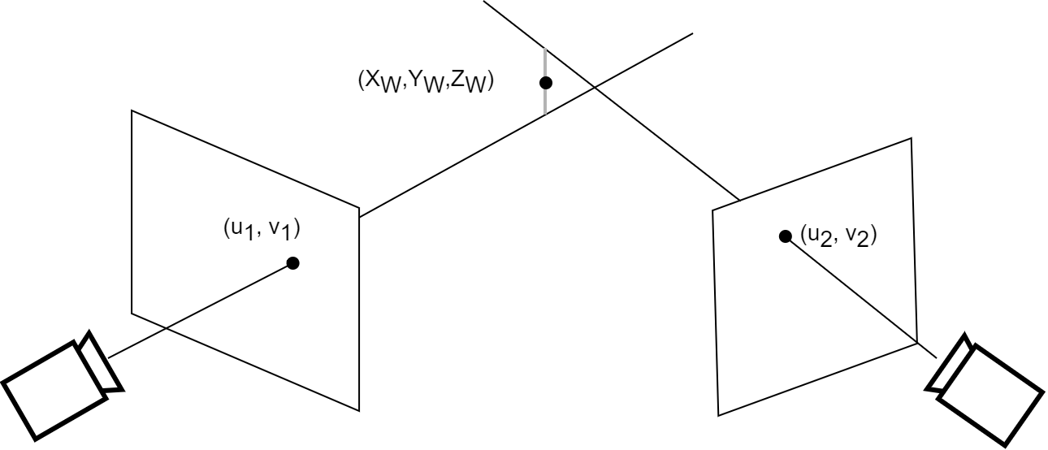
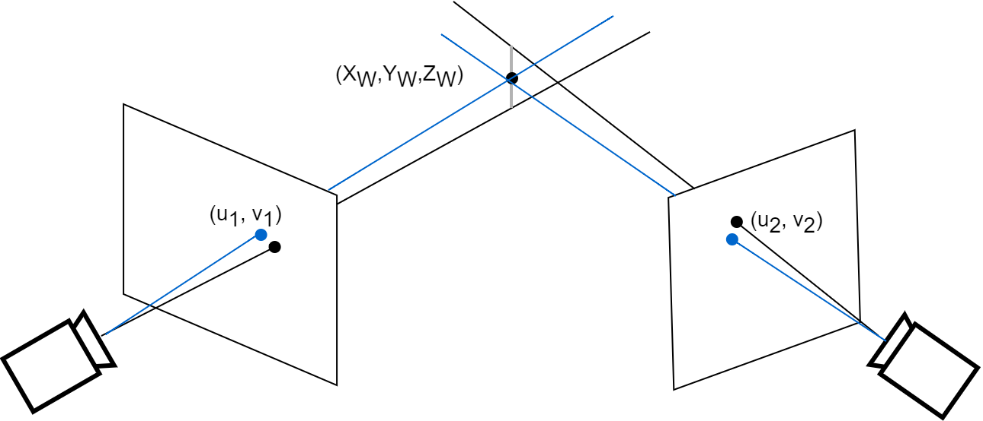
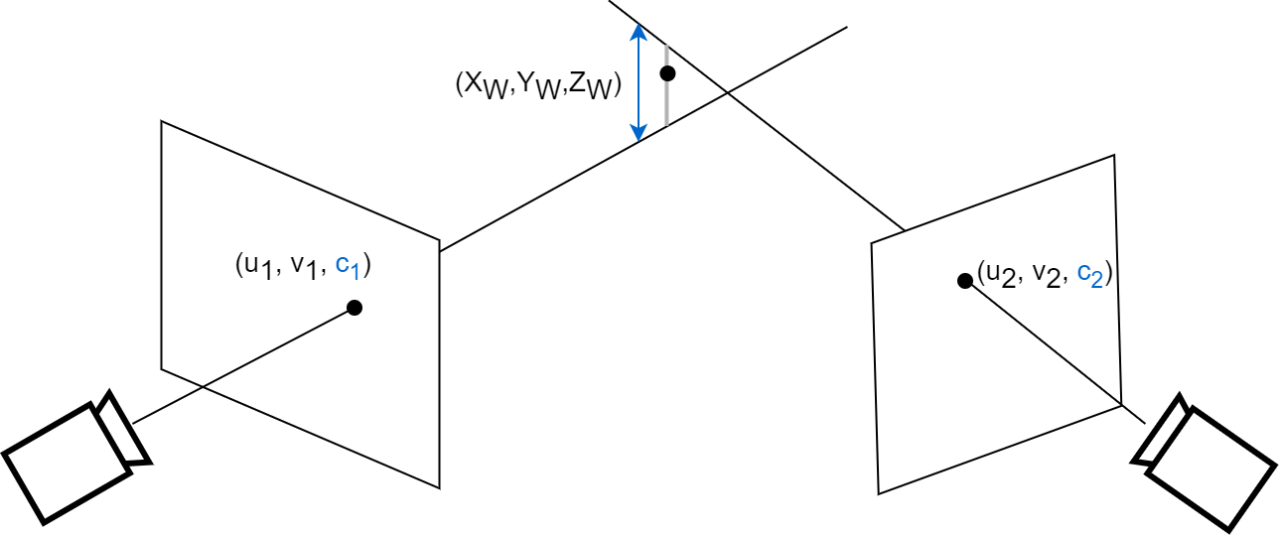
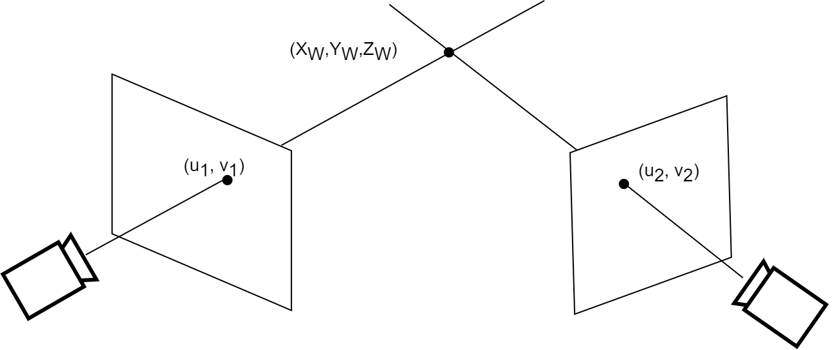
2D images to 3D angles
Triangulation
With computer vision
Ideal case: Epipolar geometry (simple trigonometry) When rays intersect (if perfect cameras & perfect 2D estimation)
In real life: e.g. Direct linear Transform (DLT) Rays never perfectly intersect: minimize reprojection error
Proposed method: Weighted DLT With confidence score that comes with each keypoint estimation More accurate, fast
Notes:
Then, 2D coordinates need to be triangulated
DLT: minimize reprojection error in the « least-square sense ».
Transformation into a homogeneous system, resolved by singular value decomposition -> least squares solution
- Last potential method : triangulate the whole heatmap of detection probabilities : even more accurate, but much much slower

Slide 22
2D images to 3D angles
Triangulation
With computer vision
Pose2Sim:
Triangulates with weighted DLT
Automatically chooses the right person to triangulate
Is robust to person exiting and entering camera field
Offers flexible settings for triangulation and filtering
Gives precise feedback: which keypoints, cameras, and frames pose problem?
Notes:
I made this triangulation more robust with a few other features

Slide 23
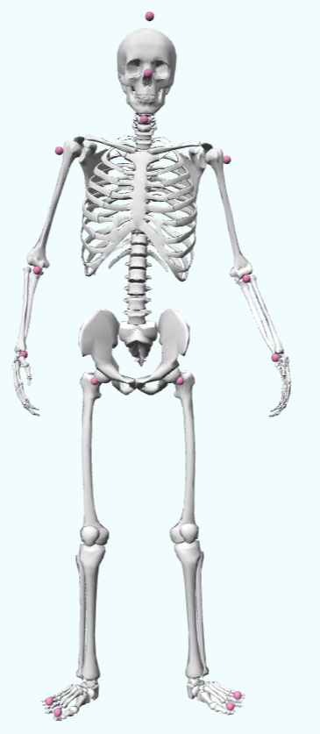
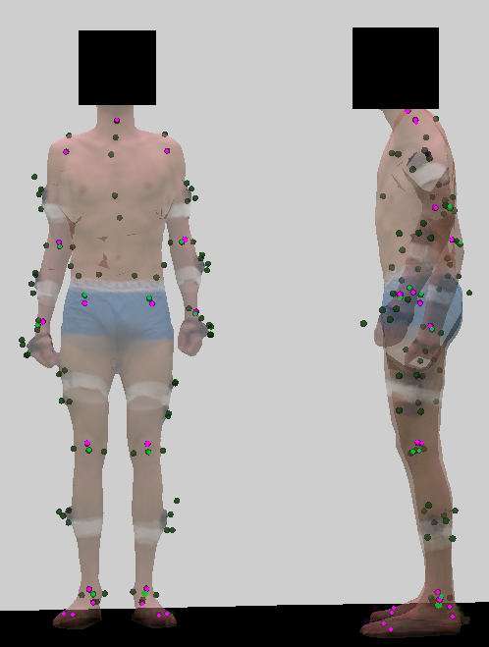
2D images to 3D angles
Model
Kinematic optimization
With biomechanics
Triangulated keypoints positions are approximate:
Systematic offset between keypoints and joint centers [Needham 2021] → Pose2Sim: Offset taken into account
Keypoint location on body may vary from frame to frame → Pose2Sim: Bone lengths are fixed
Triangulated keypoints are sparse:
21 keypoints, 20 joints × 3 (or 6) degrees of freedom: need for constraints
Pose2Sim: Knee abduction & internal rotation constrained to flexion [Rajagopal 2015, IEEE]
Pose2Sim: Each vertebra constrained to the previous one [Beaucage-Gauvreau 2019, Comp Met]
Pose2Sim: Angle limits are defined for each joint
Scaling
Inverse
kinematics
[Pagnon 2022, Sensors]
Notes:
Finally, these 3D coordinates need to be constrained to a biomechanically consistent skeleton, for several reasons
There are more unknowns than equations, and we need for constraints
When you flex your knee, it naturally moves around other axis, and it also translates: this is natural
More natural curvature of the spine

Slide 24



2D images to 3D angles
Model
Kinematic optimization
With biomechanics
Triangulated keypoints positions are approximate and sparse
Everyone has different size and proportions:
Distances between markers determine segment dimensions
Keypoint positions are subject- and operator-agnostic → Pose2Sim: No need for adjustments once the model is defined
Scaling
Scaled model follows keypoint movements
Joint angles optimized to minimize distance between triangulated keypoints and model keypoints
Inverse
kinematics
$$min\sum_{k ∈ keypoints}{{\left\|{Coord}^{trig}−{Coord}^{model}(angles)\right\|}^{2} }$$
Keypoints attached to the model
Triangulated keypoints to follow
Notes:
Everyone has different sizes and propostions. Hence, the model we just designed needs to be scaled
Segments will be stretched according to distances between keypoints
Fortunately, there is no need for keypoint adjustments once the model is defined, unlike in marker-based methods

Slide 25

2D images to 3D angles
Pose2Sim summary
Crossover of several research fields:
2D pose estimation with deep learning
Robust triangulation with computer vision
Consistent kinematics with biomechanics
Pose2Sim is:
Open-source, with extensive documentation
Flexible:
- any 2D pose estimation,
- custom triangulation parameters,
- custom kinematic model
Gives feedback to user
Continuously integrated: automatic tests at each commit
Easy to install: pip install pose2sim
Used : 13k downloads, 51☆, 20 issues
Peer-reviewed in JOSS [Pagnon 2022b, JOSS]
Notes:
To sum it up,
(+ emails) Blender add-on, GUI being developed, tried by several labs & companies

Slide 26
Robustness
01
02
Introduction
From 2D images to 3D joint angles
04
05
Accuracy
Application case
03
Robustness
What is MoCap?
Why do we need markerless in sports?
Crossover of numerous research fields.
Building an open-source solution.
Does it actually work? Comparing results
under challenging capture conditions
06
Perspectives
Comparison to a marker-based process.
Boxing, using unsynchronized and uncalibrated GoPros.
Enhancing the markerless process.
Data fusion when video is challenged
Notes:
So, this is all nice and well, but does it actually work?
2 important aspects to validate:
Robustness: assessed by comparing results under challenging capture conditions
Accuracy: Assessed by comparing them to a reference marker-based method

Slide 27



Robustness
Exploring robustness
Changing capture conditions?
Involves numerous capture sessions
Involves assuming no subject variability
Unless… Conditions were changed after capture
Kinovis platform:
68 video cameras (+ 20 marker-based ones)
Capture of body shape and texture
Scene recreation with different conditions
Pose2Sim workflow
Comparison of kinematics
under several challenging conditions
Notes:
. Time and resource consuming
. Subject behaves exactly the same way from one capture session to another
The good news, is that we can do it, and simulate different capture conditions, thanks to the Kinovis pl…
Visual hull reconstruction + texture mapping
(Great flexibility in capture conditions : any number/type cameras, any environment, + first wanted to work with digital twin)

Slide 28


Robustness
Robustness assessment
Robustness regarding:
Activities: walking, running, cycling
Subject exiting the field of view
Additional persons entering the scene
Assessed separately against:
Image quality → dark scene, defocused objectives
Occlusions → filming with half as many cameras
Poor calibration → random 1 cm residuals
[Pagnon 2021, Sensors]
Notes:
Hence, we evaluate robustness regarding…
Robustness is also assessed separately

Slide 29



Robustness
Robustness results
Hip flexion/extension in walking
Very good agreement with reference condition
Across all simulated conditions, activities, planes of movement, and joints: MAE < 5.7°
1 cm calibration error → virtually no difference: r=1.0, MAE<1°, std<2.5°
Fewer cameras and poor image quality → more challenging, especially out of the flex/ext plane, especially on the cycling task
⚠ 1 single subject, 10 cycles per task
⚠ Simple sagittal movements
⚠ Virtual scene
Hip int/ext rotation in running
Subtalar angle in cycling
[Pagnon 2021, Sensors]
Definitions:
MAE: Mean absolute error (re. reference)
r: Pearson’s correlation coefficient (with reference condition)
std: Standard deviation
Notes:
Overall, we obtain very good…
Stays under 5.7°
variability barely increased at all as compared to the ref condition
Running hip int/ext, cycling subtalar

Slide 30


2D images to 3D kinematics
Robustness summary
Pose2Sim is robust to:
Calibration errors: 1 cm makes no difference, while < 1 mm advised with markers
Image quality: only mildly sensitive to lighting and focus, while marker- based systems hardly work in non-optimal conditions (e.g., outdoors)
Occlusions: makes guess, while markers are either visible or not
[Pagnon 2021, Sensors]
Results are similar regardless of the condition.
Are they accurate?
Quickmeme.com
Shutterstock.com
Notes:
They could shoot in the same direction regardless of the condition, but still be consistently off

Slide 31
Accuracy
01
02
Introduction
From 2D images to 3D joint angles
04
05
Accuracy
Application case
03
Robustness
What is MoCap?
Why do we need markerless in sports?
Crossover of numerous research fields.
Building an open-source solution.
Does it actually work? Comparing results
under challenging capture conditions
06
Perspectives
Comparison to a marker-based process.
Boxing, using unsynchronized and uncalibrated GoPros.
Enhancing the markerless process.
Data fusion when video is challenged
Notes:
After robustness, accuracy needs to be assessed

Slide 32



Accuracy
Accuracy assessment
Comparison with a marker-based method
Systematic position bias up to 5 cm (knee, hip). Reported by [Needham 2021]
→ systematic angle bias?
Could be precise, but inaccurate…
Marker-based protocol:
20 marker-based cameras (vs. 8 virtual video cameras)
83 markers + 8 calculated joint centers (vs. 21 keypoints)
Same kinematic model
Marker adjustments during scaling (vs. subject agnostic & no soft tissue artifacts)
[Pagnon 2022, Sensors]
Notes:
It has been shown that pose estimation models suffer from a systematic bias that can reach up to 5 cm,especially for knee and hip joint centers
It is legitimate to think that it would lead to a syst ang bias
To assess our accuracy, we compare its results with those of a marker-based protocol

Slide 33




Accuracy
Accuracy results
Hip flex/ext in walking
Pelvic flex/ext in walking
Grand mean errors:
3.0° in walking
4.1° in running
4.1° in cycling
Very good agreement in flex/ext
except for pelvis
except for offsets in hip in running (15°) and ankle in cycling (6.7°)
Less good on other planes of movement, esp. in cycling.
Hip flex/ext in running
Ankle flex/ext in cycling
Notes:
Results, again, are rather satisfying

Slide 34
Accuracy
Comparison
with other systems
Walking | RMSE (range)
Theia [Kanko 2021] | 6.4° (3.3°–11°)
Pose2Sim [Pagnon 2021] | 4.9° (3.1°–6.6°)
[Needham 2022] | 4.9° (2.9°–6.0°)
OpenCap [Uhlrich 2022] | 4.9° (2.9°–6.0°)
⚠ Highly constrained kinematic model
Assumes similar joint mechanics within all human beings
⚠ Marker-based methods ≠ gold-standard Unlike biplanar videography / MRI / bone-anchored pins / 3D ultrasound
9° errors vs gold standard [Kessler 2019]
10° inter-operator errors [Gorton2009]
3° soft tissue artifacts [Benoit2015]
3° joint position errors [Leboeuf2019]
Good accuracy, good robustness.
But pelvic region less accurate, while sometimes investigated in gait analysis [Saunders 1953]
Lower-body analysis of simple motion:
What about real sports movements, in a real setting?
[Pagnon 2022a, Sensors]
Definition:
RMSE: Root mean square error (re. reference)
Walking | RMSE (range) | MAE (range) | Bias (range)
Theia [Kanko 2021] | 6.4° (3.3°–11°) | N/A | N/A
Pose2Sim [Pagnon 2021] | 4.9° (3.1°–6.6°) | 4.3° (2.9–6.1°) | 3.0° (1.9°–5.3°)
[Needham 2022] | 4.9° (2.9°–6.0°) | N/A | 4.2° (2.5°–5.1°)
OpenCap [Uhlrich 2022] | 4.9° (2.9°–6.0°) | 4.2° (2.5°–5.1°) | N/A
✅First to come, user friendly, peer-reviewed
❌Commercial, black box, not flexible, results slightly off
✅Flexible, peer-reviewed
❌Virtual scene, few validating data
✅Multi-person, peer-reviewed, Kalman filter
❌Not released, simple triangulation, simpler kinematic model
Estimates location of 43 markers from triangulated OpenPose keypoints
✅User friendly, less cameras needed, better for pelvic region, estimation of dynamics
❌Simpler kinematic model, model might not work as well on untrained activities ❌Not GDPR compliant, Not peer-reviewed (yet)
Notes:
If we compare our results with others from the literaure, by order of publication, we can see that aside from Theia which is a little behind, the 3 other solutions offer quite a similar level of accuracy,d espite slightly different approaches.
Marker-based best available
(Theia might have improved since then
Needham: Kalman filter for outlier rejection, only body_25 openpose)

Slide 35
Application case
01
02
Introduction
From 2D images to 3D joint angles
04
05
Accuracy
Application case
03
Robustness
What is MoCap?
Why do we need markerless in sports?
Crossover of numerous research fields.
Building an open-source solution.
Does it actually work? Comparing results
under challenging capture conditions
06
Perspectives
Comparison to a marker-based process.
Boxing, using unsynchronized and uncalibrated cheap cameras.
Enhancing the markerless process.
Data fusion when video is challenged
Notes:
When it becomes real: more complex task, not in virtual scene anymore

Slide 36



Application case
Addressing sports
Sports movements:
3D, fast, full-body
→ Capture shadow-boxing sequence: 6 repetitions by 3 elite athletes
→ Determine and measure Key Performance Indicators (KPIs)
Sports conditions:
Need for fast, not cumbersome, cheap setup
→ GoPros: lightweight, wireless, consumer-grade cameras
→ But uncalibrated & unsynchronized
Comparison study:
Research-grade
(10 Qualisys IR)
(8 Qualisys video)
(8 GoPros)
Are KPIs accurately retrieved by markerless analysis?
Is consumer-grade hardware good enough?
Consumer-grade
Notes:
Finally, we are addressing sports, with its challenges.
6 reps of jab, high hook, low hook
KPIs: with the help of scientific director of federation, existing literature
Research-grade definitely not answering these requirements
The question is two-fold:
task with jabs translational, and hooks rotational

Slide 37


Application case
Calibration
Matching Image / World coordinates
Image 2D coordinates
Intrinsic parameters
(+distortion)
Extrinsic
parameters
World 3D coordinates
Intrinsic parameters: Image 2D → Camera 3D
What kind of camera is it?
Can be done off-line
Extrinsic parameters: Camera 3D → World 3D
Where is the camera?
Requires on-field information
Feature in 2D image with coordinates (u,v) corresponds to 3D object with coordinates (Xc, Yc, Zc) in camera frame of reference, and each camera frame of ref can be expressed in global world coordinates (Xw, Yw, Zw) In other words, this 2D character corresponds to a real 3D boxer seen by this camera, and his coordinates can be expressed in other 3D global coordinates common to all cameras
OpenCV tools: Checkerboard for intrinsics (calibrateCamera), pairing scene to image once intrinsics known (solvePnP)
3 eqn, 4 unknown: need at least 2 points of view to determine
Little hole not centered + distortion
Notes:
The first problem that needs to be addressed when using consumer-grade cameras, is calibration
Consists in matching image 2D coordinates (uv) to world 3D coordinates (Xw,Yw,Zw)
Usually 2 steps : first, determining intrinsic parameters, which answer the question: « what kind » (focal, optical center, disto)
The second step consists in determining ext

Slide 38



Application case
Calibration
Matching Image / World coordinates
Calibration = main stumbling block for users
→ Need for user-friendly tool
Intrinsic parameters: with checkerboard
Extrinsic parameters: with intrinsic parameters
+ object of known dimensions on scene
Intrinsics (off-line)
Extrinsics (on-field)
Check validity: Compare clicked and reprojected points
Calibration errors: 2.5 cm
Not fully integrated in Pose2Sim yet (but workable scripts are provided)
Notes:
According to the github issues,
I propose to determine intr params in a very standard way, with a checkerboard
Extrinsic param are then calculated:
• Collected world coordinates of lines and cornes on the ring • Click corresponding points on image • Match world and image coordinates (‘Perspective n Point’ algorithm) → Extrinsic parameters
(of known dimensions
• Take several pictures of it • Automatically detect corners • Match world and image coordinates (OpenCV `calibrateCamera`)
)

Slide 39

Application case
Synchronization
With correlation of keypoint speeds
How to synchronize cameras?
Cables: too cumbersome
Flash or clap: not workable in competition
Wireless or sound: not robust
→ Only use image information?
User can choose one or several keypoints, and weigh them.
Tested with different kinds of movements
Offset applied to each view accordingly → Synchronization to the frame
Not fully integrated in Pose2Sim yet (but workable script is provided)
Assumption:
Two cameras are synchronized
when vertical keypoint speeds are maximally correlated
Independently proposed by OpenCap [Uhlrich 2022]
Notes:
The next challenge is the synchronization of cameras :
WiFi, bluetooth, GPS
In practice, the user can choose…
Here you can see the vertical speed of the right hand performing a fast movement, and you can notice how clearly the offset is rendered, which allows to synchronize each view to the frame
Worked equally well with fast vertical hand movement, free walking across the scene, boxing sequence

Slide 40






Application case
KPI accuracy results
Research-grade markerless vs. marker-based:
Onset times: sub-frame agreement Errors <15 ms = 0.9 frames (@60fps)
Peak translations: Sub-centimeter agreement Position errors: <1 cm and speeds: < -0,4m/s
Peak rotations: Slight offsets, especially in pelvis & upper-body (up to 5.4°)
Consumer-grade hardware vs. research-grade:
Very slight differences, despite post-calibrated & post-synchronized
Rotations: up to 8.6° errors vs. up to 5.4°
—— Marker-based —— Research-grade markerless —— Consumer-grade markerless
Notes:
Once these two issues were addressed, we could conduct the markerless analysis, and compare it to the marker-based protocol
When comparing the consumer-grade protocol to the research-grade one,
Jab, jab, hook
RMSE 0,85 cm, 2,1 cm ; 4,1°, 10,8° ; 6,9°, 8,6°
ROM: 1,1 cm, 1,0 cm ; -2,9, -8,6 ; -3,9, -7,9 -> 2,9-5,4, 2,7-10,2
Time: -0,9 ms, -14,8 ms ; -3,7, -2,8 ; 18,5, 28,5

Slide 41
Application case
Application case summary
Markerless is relevant
for whole-body, 3D, on-field sports analysis
Markerless with consumer-grade hardware is also relevant
With lightweight, wireless, cheap cameras
With relatively straightforward calibration and synchronization procedures
[Pagnon 2022c]
⚠ Dearth of keypoints, systematic offset: inaccuracies in pelvis, knee, elbow
⚠ Constrained model in marker-based and markerless procedures: inaccuracies in shoulder
⚠ Single person analysis: not workable in actual fights
Notes:
Calib & Synchro : prêt à mettre dans release
Only 21 keypoints, and they are not even accurate: despite our best efforts in triangulation and kinematic procedures, leads to inaccuracies, especially
Multi-person: know how to, but no time

Slide 42
Perspectives
01
02
Introduction
From 2D images to 3D joint angles
04
05
Accuracy
Application case
03
Robustness
What is MoCap?
Why do we need markerless in sports?
Crossover of numerous research fields.
Building an open-source solution.
Does it actually work? Comparing results
under challenging capture conditions
06
Perspectives
Comparison to a marker-based process.
Boxing, using unsynchronized and uncalibrated GoPros.
Enhancing the markerless process.
Data fusion when video is challenged
Notes:
This leads me to the outcomes and perspectives of this thesis

Slide 43
Perspectives
Perspectives
How close are we from an ideal MoCap system?
Ideal motion capture system?
⍰ Accurate
⍰ No interference with natural movement
⍰ Simple
⍰ Quick set up and analysis
⍰ Cheap
[Atha 1984]
→ Need for more and better labelled keypoints
→ OK
→ Need for user-friendly calibration and synchronization + GUI
→ OK
→ Bottleneck: 2D pose
→ 5,000 € vs. 50,000 €
Notes:
How close are we from our ideal?

Slide 44


Perspectives
Perspectives
Going further in challenging cases
Example case: BMX race
Vast field of view
Large occlusions
Equipment to detect
Preliminary study:
Pilot detection with OpenPose
Bike detection by DeepLabCut
Perspectives:
Adding kinematic constraints between feet-pedals, hand-handle
Positioning a few IMUs on feet and hands for orientation priors
Pose2Sim → Unsatisfying results
Notes:
We could also try and go further in particularly challenging cases
Vast field of view: pilot and bike small on images, and seen just for a few frames
Some additional perspectives to obtain better results would be,
either to…
Perform some kind of data fusion

Slide 45
Conclusion
01
02
Introduction
From 2D pose to 3D joint angles
04
05
Accuracy
Application case
03
Robustness
What is MoCap?
Why do we need markerless in sports?
Crossover of numerous research fields.
Building an open-source solution.
Does it actually work? Comparing results
under challenging capture conditions
06
Perspectives
Comparison to a marker-based process.
Boxing, using unsynchronized and uncalibrated GoPros.
Enhancing the markerless process
Data fusion when video is challenged

Slide 46


Conclusion
Conclusion
I am grateful:
For this opportunity of mixing sports and science together
That results ended up being satisfactory after a year and a half of unconclusive wandering
For the opportunities of publishing my work Peer-reviewed articles: 3(+1), Conferences: 2
And of releasing a workable tool Used by several labs and companies
Still so much more to look into!
Svgforest.com
Notes:
Indeed, and this is my little story, I first tried to conciliate sports and research in quantum physics, which I was studying back then. This felt as impossible as keeping a cat both dead and alive. Hence, I first had to give up research for a carreer of parkour artist, and then to give up this carreer too after a few years. And yet, somehow now it seems like I could find a good mix of sports and research in the same project, which I am very grateful for.
Along the way, it also lead to the release of a workable tool
And yet, the more I dig, the more I realize there is still so much to look into…
Anyway. This is the end of a cycle, but looking forward to exploring new opportunities!

Slide 47
Thanks
Thank you
contact@david-pagnon.com
+33 6 19 86 06 57
http://david-pagnon.com

Slide 48
Bibliography
LOPER (2015) SMPL: a skinned multi-person linear model. ACM Transactions on Graphics
LIU (2022) Auto calibration of multi-camera system for human pose estimation. IET Computer Vision
MAHMOOD (2019) AMASS: Archive of Motion Capture as Surface Shapes. ICCV
MATHIS (2018) DeepLabCut: markerless pose estimation of user-defined body parts with deep learning. Nature Neuroscience
MATTHIS (2022) FreeMoCap: A free, open source markerless motion capture system, Zenodo
MOESLUND (2001) Review - A Survey of Computer Vision-Based Human Motion Capture. Computer Vision and Image Understanding
NEEDHAM (2021) The accuracy of several pose estimation methods for 3D joint centre localisation. Scientific reports
NEEDHAM (2022) The development and evaluation of a fully automated markerless motion capture workflow, Journal of Biomechanics.
OSMAN (2020) Star: Sparse trained articulated human body regressor. ECCV
PAGNON (2021) Pose2Sim: An End-to-End Workflow for 3D Markerless Sports Kinematics—Part 1: Robustness. Sensors
PAGNON (2022a) Pose2Sim: An End-to-End Workflow for 3D Markerless Sports Kinematics—Part 2: Accuracy. Sensors
PAGNON (2022b) Pose2Sim: An open-source Python package for multiview markerless kinematics. Journal of Open Source Software
PAGNON (2022c) A 3D markerless protocol with action cameras – Key performance indicators in boxing. ECSS
PEREIRA (2022) SLEAP: A deep learning system for multi-animal pose tracking. Nature methods
PETIT (2010) Multicamera real-time 3d modeling for telepresence and remote collaboration, International journal of digital multimedia broadcasting
RAJAGOPAL (2015) Full-Body Musculoskeletal Model for Muscle-Driven Simulation of Human Gait. IEEE Transactions on Biomedical Engineering
REMPE (2020) Contact and Human Dynamics from Monocular Video. ECCV
SENGUPTA (2020) Synthetic training for accurate 3d human pose and shape estimation in the wild. arXiv
UHLRICH (2022) OpenCap: 3D human movement dynamics from smartphone videos. biorXiv
WANG (2022) YOLOv7: Trainable bag-of-freebies sets new state-of-the-art for real-time object detectors. arXiv
WOOD (2021) Fake it till you make it: face analysis in the wild using synthetic data alone. IEEE/CVF
ATHA (1984) J Current techniques for measuring motion. Applied ergonomics
BEAUCAGE-GAUVREAU (2019) Validation of an OpenSim full-body model with detailed lumbar spine for estimating lower lumbar spine loads during symmetric and asymmetric lifting tasks. Computer Methods in Biomechanics and Biomedical Engineering
BENOIT (2015) Surface marker cluster translation, rotation, scaling and deformation: Their contribution to soft tissue artefact and impact on knee joint kinematics. Journal of Biomechanics
BOGO (2016) Keep it SMPL: Automatic estimation of 3D human pose and shape from a single image. In Computer Vision–ECCV
BOLAÑOS (2021) A three-dimensional virtual mouse generates synthetic training data for behavioral analysis. Nature methods
CAO (2019) OpenPose: realtime multi-person 2D pose estimation using Part Affinity Fields. IEEE transactions on pattern analysis and machine intelligence
DONG (2021) Fast and robust multi-person 3d pose estimation and tracking from multiple views. IEEE Transactions on Pattern Analysis and Machine Intelligence
FANG (2017) RMPE: Regional Multi-person Pose Estimation. IEEE International Conference on Computer Vision (ICCV)
FERRARI (2010) A new formulation of the coefficient of multiple correlation to assess the similarity of waveforms measured synchronously by different motion analysis protocols. Gait & posture
GORTON (2009) Assessment of the kinematic variability among 12 motion analysis laboratories. Gait and Posture
HARNETT (2022) Validating an inertial measurement unit for cricket fast bowling: a first step in assessing the feasibility of diagnosing back injury risk in cricket fast bowlers during a tele-sport-and-exercise medicine consultation. PeerJ
KARASHCHUK (2021) Anipose: a toolkit for robust markerless 3D pose estimation. Cell reports
KANKO (2021) Concurrent assessment of gait kinematics using marker-based and markerless motion capture. Journal of Biomechanics
KESSLER (2019) A Direct Comparison of Biplanar Videoradiography and Optical Motion Capture for Foot and Ankle Kinematics. Front. Bioeng. Biotechnol
LEBOEUF (2019) The effect on conventional gait model kinematics and kinetics of hip joint centre
equations in adult healthy gait. Journal of Biomechanics

Slide 49

Smallest worthwhile change
Quantifying accuracy requirements
First, reasonable results as compared to known marker-based errors: 9° errors vs gold standard [Kessler 2019]
10° inter-operator errors [Gorton2009]
3° soft tissue artifacts [Benoit2015]
3° joint position errors [Leboeuf2019]
Is the markerless protocol accurate enough to detect SWC?
SWC = 0.2 x SD
Mean inter-protocol differences
marker-based vs. markerless with GoPros
Knee flexion Mean_{err} = 3,3°
Pelvis rotation Mean_{err} = 4.9°
Shoulder Mean_{err} = 1.1°
Between-subjects SWC:
→ More than enough to differentiate athletes
Within-subject SWC:
Very small (experts): Order frame, mm, dm/s, 1°
Knee flexion SWC = 0.7°
Pelvis rotation SWC = 0.9°
Shoulder SWC = 1.1°
→ Not enough to differentiate trials
Between-subjects SWC
in more normative movements (cricket): [Harnett 2022]
Knee flexion SWC = 1.9°
Pelvis rotation SWC = 1.2°
Shoulder SWC = 3.9°
→ Might be enough
Notes:
May not be worth detecting a 10th of a degree if actual differences are more of the order of 10 degrees.
Depends on sports, type of movement, expertise, etc
Not enough subjects

Slide 50



Triangulation
With computer vision
Full 3D pinhole model in world coordinate system:
Simplified pinhole model
Thales theorem : $\frac{Z_{c}}{f}=\frac{X_{c}}{u}$ → Zc u = f Xc
Scale
factor
Image coordinates
Intrinsic parameters
Extrinsic
parameters
World coordinates
Projection matrix

Slide 51

Pose2Sim tools & workflow
OpenPose
Sparse and approximate
2D keypoints
OpenSim
3D joint angles
Pose2Sim
Camera calibration & synchronization
Sorting people, triangulation, filtering
Kinematic model, scaling & inverse kinematics setup files
Notes:
OpenPose: most widespread in research literature, best compromise accuracy/speed, open-source
OpenSim: arguably the most widespread in biomechanics, open-source
-> both open-source and arguably the most widespread/standard in research literature
Cal & sync: keep for a next chapter

Slide 52
Perspectives
Perspectives
Ideal motion capture system?
⍰ Accurate
⍰ No interference with natural movement
⍰ Simple
⍰ Quick set up and analysis
⍰ Cheap
[Atha 1984]
→ Need for more and better labelled keypoints
→ OK
→ Need for user-friendly calibration and synchronization + GUI
→ OK
→ Bottleneck: 2D pose
→ 5,000 € vs. 100,000 €
Accuracy: More and better labelled keypoints?
Build a new dataset with minimal labeling effort
Gather numerous sports marker files
Fit an SMPL shape [Mahmood 2019]
Add clothing, scene, cameras. Change shape parameters. Add equipment [Bolanos 2021, Wood 2021]
Label keypoints or segment shapes on one frame (SMPL: constant topology)
Simplicity: Use in training, not only in research?
Enhance Pose2Sim
Simplify synchronization procedure
Simplify calibration (on a person’s limb dimensions like with wand) [Liu 2022]
Support multi-person analysis [Dong 2019]
Build GUI
Estimate dynamics
Preprint published yesterday
Better accuracy when using
MMPose pose detector with Halpe dataset
Optimization of parameters of implicit function
Notes:
How close are we from our ideal?
Accuracy: fit with AMASS, scene cf face (fake it) or mouse
Simplicity: Simple install & commands Calibration on limb dimensions (like with wand) [Liu 2022] Multi-person: brute-force (triangulate combination of persons, if reproj error too big, try different combination), or network with affinity score [Dong 2021]
Speed: On a standard laptop: OpenPose 0.5 frames/s, triangulation 10 frames/s, OpenSim 20 frames/s. BlazePose, YOLOpose, etc. Quasi real time: capture, a few seconds, and feedback

Slide 53



Pose2Sim config & log files
Pose2Sim:
Triangulates with weighted DLT
Automatically chooses the right person to triangulate
Is robust to person exiting and entering camera field
Offers flexible settings for triangulation and filtering
Gives precise feedback: which keypoints, cameras, and frames pose problem?
Config file
Log file
Notes:
I made this triangulation more robust with a few other features:
Chooses person: brute force (potentially better with neural network affinity score -> matching) Triangulates a chosen point If above chosen reproj error threshold, try other person on a camera, then on other camera. If still above after all persons from all cameras, removes a cam from calculation
Exit field: removes camera if reprojection error too high, skip frame and interpolate if not enough cameras to triangulate
Settings: thresholds on reprojection error, confidence score, etc
Feedback: for each keypoint: reprojection error & which frames were interpolated; for each camera: rate of exclusion

Slide 54
Credits
Adapted from:
Presentation template by Slidesgo
Icons by Flaticon and David Pagnon
Infographics by Freepik and David Pagnon
Images created by Freepik and David Pagnon
Author introduction slide photo created by Freepik
Text & Image slide photo created by Freepik.com
Notes:
CMC
correlation, offset, gain
inter-protocol (as opposed to within-day or between-day) Excludes stride-to-stride variability & inter-subject variability
1- Ratio of a Sum of sum of sum of squares, take the square root
Other gait event detection algorithms?
Could have tested minimum vertical velocity (O'Connor2007) instead of coordinates-based (heel behind sacrum, Zeni2008).
To my knowledge, other methods involve additional equipment such as force place or IMUs.
Very low cut-off frequency for kinematics.
Winter 1974 initially, Barlett2007)
Racz 2021 Cut-off 6.25*cadence
Roughly explored with power spectrum analysis, not much information above 6 Hz (10Hz for boxing).
If dynamics, would need for more thorough exploration and higher cut-off freq.
How can we get better at dealing with occlusions?
More cameras, or learning markers cf OpenCap, or shape estimation for more information
Volumetric / SMPL methods vs. sparse point approach?
Shape: more information that sparse keypoints, potentially also inertial properties.
BUT not necessarily more exact, more computationally intensive.
Would be good to create a more global dataset, that would make training on shapes + keypoints possible (and that could be augmented with new movements/keypoints/conditions with little labelling and short training)
Synthetic images. Are scenes realistic enough?
There are ways to quantify the properties of a dataset of images.
Does it covers a large space, with a large variability ? Is there a domain gap between real data & synthetic data?

